Slide 1
The History of DRAM Technology
Xixi Chen
2020-04-11

Slide 2
What's DRAM?
DRAM: usually means DDR SDRAM
Double Data Rate
DDR: the other technology may use SDR or QDR.
Synchronous
I/O and control signals are synchronized with an external clock.
The originally dram is Asynchronous.
Dynamic
Dram Cell is capacitor, leak all the time, should refresh periodically.
Random Access Memory
Access Memory by any address, no need to sequential.

Slide 3
SDR DDR QDR
SDR DRAM uses SDR.
(LP)DDR DDR2 DDR3 DDR4 DDR5 use DDR.
GDDR5X uses DDR or QDR.

Slide 4
DDR or QDR of GDDR5X

Slide 5
Why DRAM not use TDR/QDR?
Triple or quadruple transfer points in a single sine wave would be possible but would require a lot more work to determine the correct timing as data would need to transfer the next bit of data not on just an easy to determine peak. its just not simple/reliable so they don't do it(remember the receiving devices decoder has to match the same timing of the sending device or it could possible read the data to late/early).

Slide 6

Asynchronous DRAM is an older type of DRAM used in the first personal computers. It is called "asynchronous" because memory access is not synchronized with the computer system clock. Modern PCs use SDRAM(synchronized DRAM) that responds to read and write operations in synchrony with the signal of the system clock.
Why was it phased out?
When a program issued an instruction to access data in asynchronous memory, the data would be accessible on the system bus some time later, but this time was variable and not guaranteed. This was acceptable on older systems, until they reached speeds of about 66 MHz.

Slide 7

Asynchronous DRAM
Conventional DRAM is controlled asynchronously, requiring the system designer to manually insert wait states to meet the specifications of the device. Timing depends on the speed of the DRAM and is independent of the system bus speed. It is these timing limitations that led to the development of the SDRAM.
SDRAM is essentially a fast DRAM with a high-speed synchronous interface. I/O‘s and control signals are synchronized with an external clock, making new options available to the designer. Simplified interface circuitry, as well as high-bandwidth data throughput can be achieved using SDRAM over conventional DRAM.

Slide 8
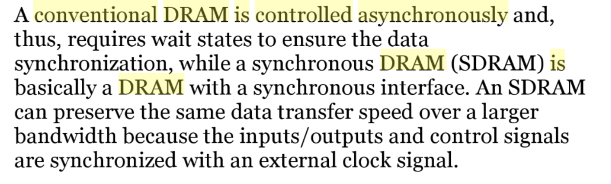

Slide 9

Dynamic
DRAM is called dynamic, because it must be refreshed all the time or it will lose the data which it is supposed to be storing.
Refreshing DRAM means reading the data from the DRAM and directly writing them back to the DRAM. DRAM is made up of millions of very small capacitors. Each of these capacitors has a transistor to let energy in and out. The capacitor slowly loses energy, and if the DRAM is not refreshed, in the end one or more of the capacitors will let so much energy out, that for example a 1 will become a 0, so data will be lost or corrupted. Almost all computers refresh their DRAM many times per second.
You can compared to Static RAM, which doesn’t need to refresh to retain the data.

Slide 10
Random Access Memory
When Row and Column Address is fixed, the real address in dram array is confirmed.
It’s like Two-Dimension Array.

Slide 11
Different “Dram” Types
GDDR Wide IO HBM HMC...

Slide 12
GDDR
GPU needs massive bandwidth, not pay attention to latency.
GDDR5 comes from DDR3.

Slide 13
Wide IO
The design of Wide IO is designed to provide high-frequency, low-power storage for mobile system single-chip (SoC). It mainly attracts smartphones and embedded systems companies.

Slide 14
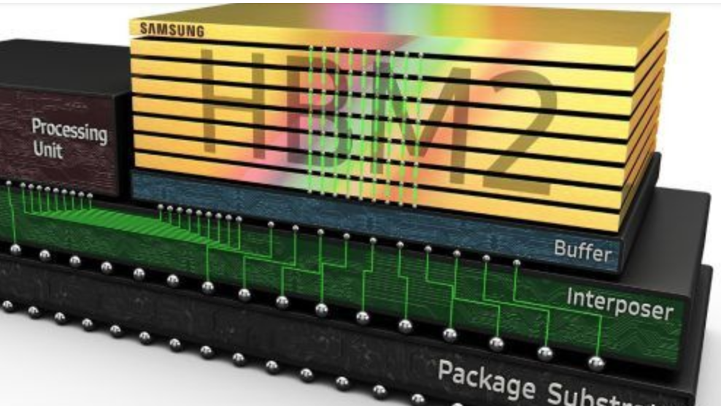
HBM
High Bandwidth Memory (HBM) is a high-performance RAM interface for 3D-stacked SDRAM from Samsung, AMD and SK Hynix. It is used in conjunction with high-performance graphics accelerators, network devices and in some supercomputers.

Slide 15
HMC
Hybrid Memory Cube (HMC) is a high-performance RAM interface for through-silicon vias (TSV)-based stacked DRAM memory competing with the incompatible rival interface High Bandwidth Memory (HBM).

Slide 16
LPDDR2 S2/S4/N
S2 means 2n prefetch, S4/N means 4n prefetch.
LPDDR2-S2 also uses a double data rate architecture on the DQ pins to achieve high speed operation. The double data rate architecture is essentially a 2n prefetch architecture with an interface designed to transfer two data bits per DQ every clock cycle at the I/O pins. A single read or write access for the LPDDR2-S2 effectively consists of a single 2n-bit wide, one clock cycle data transfer at the internal SDRAM core and two corresponding n-bit wide, one-half- clock-cycle data transfers at the I/O pins.
LPDDR2-S4 and LPDDR2-N also use a double data rate architecture on the DQ pins to achieve high speed operation. The double data rate architecture is essentially a 4n prefetch architecture with an interface designed to transfer two data bits per DQ every clock cycle at the I/O pins. A single read or write access for the LPDDR2-S4 and LPDDR2-N effectively consists of a single 4n-bit wide, one clock cycle data transfer at the internal SDRAM/NVM core and four corresponding n-bit wide, one-half-clock-cycle data transfers at the I/O pins.

Slide 17
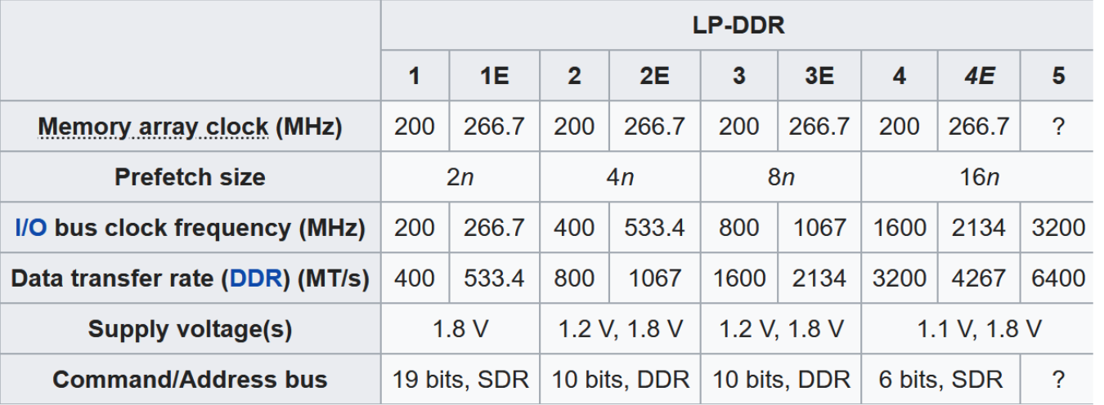
LPDDR E Series
Core Freq: 266.7MHz

Slide 18
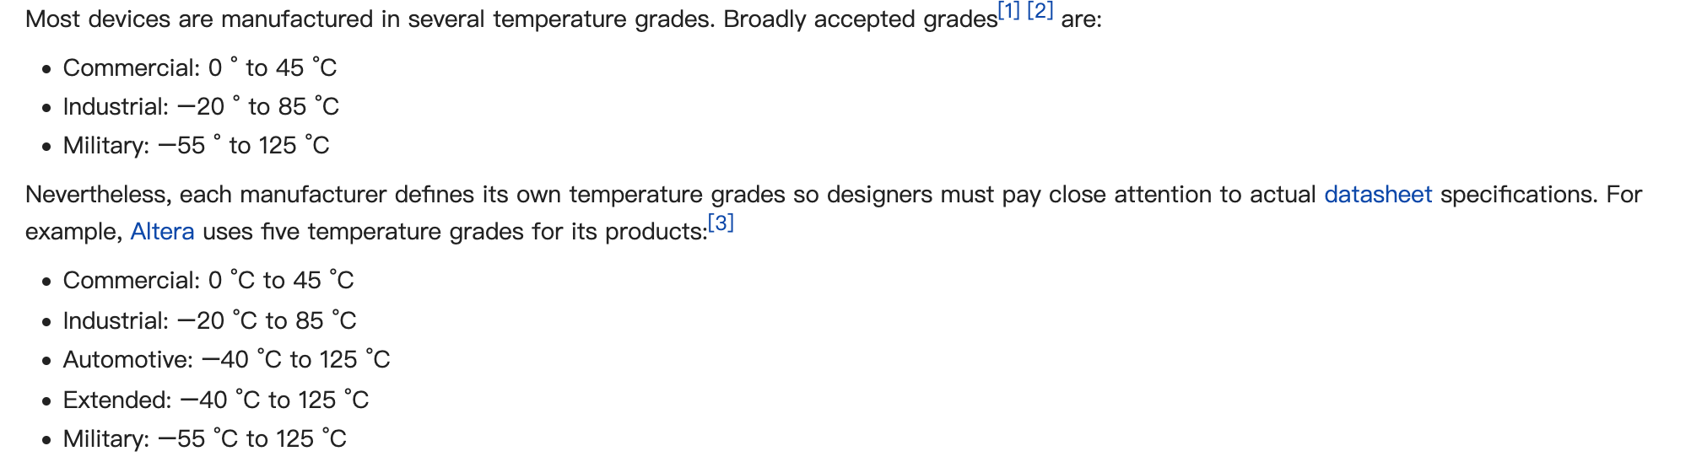
Commercial/Industrial/Automotive Grade
The use of such grades ensures that a device is suitable for its application, and will withstand the environmental conditions in which it is used.

Slide 19
Latest DRAM innovation
DDR4 -> DDR5
LPDDR4 -> LPDDR5

Slide 20
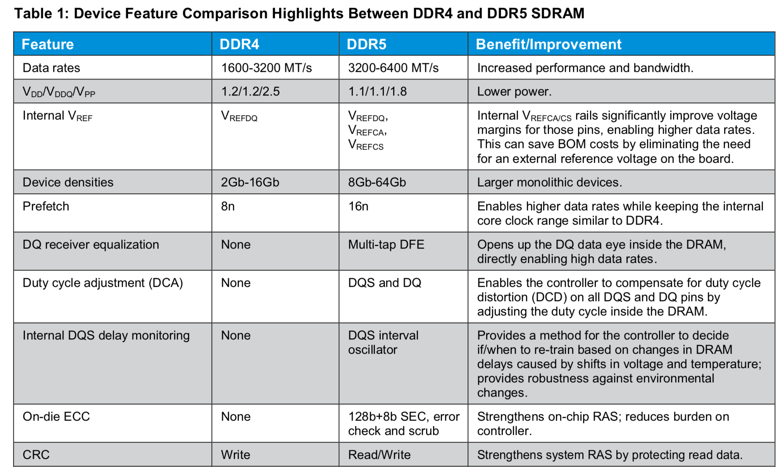
DDR4 → DDR5

Slide 21
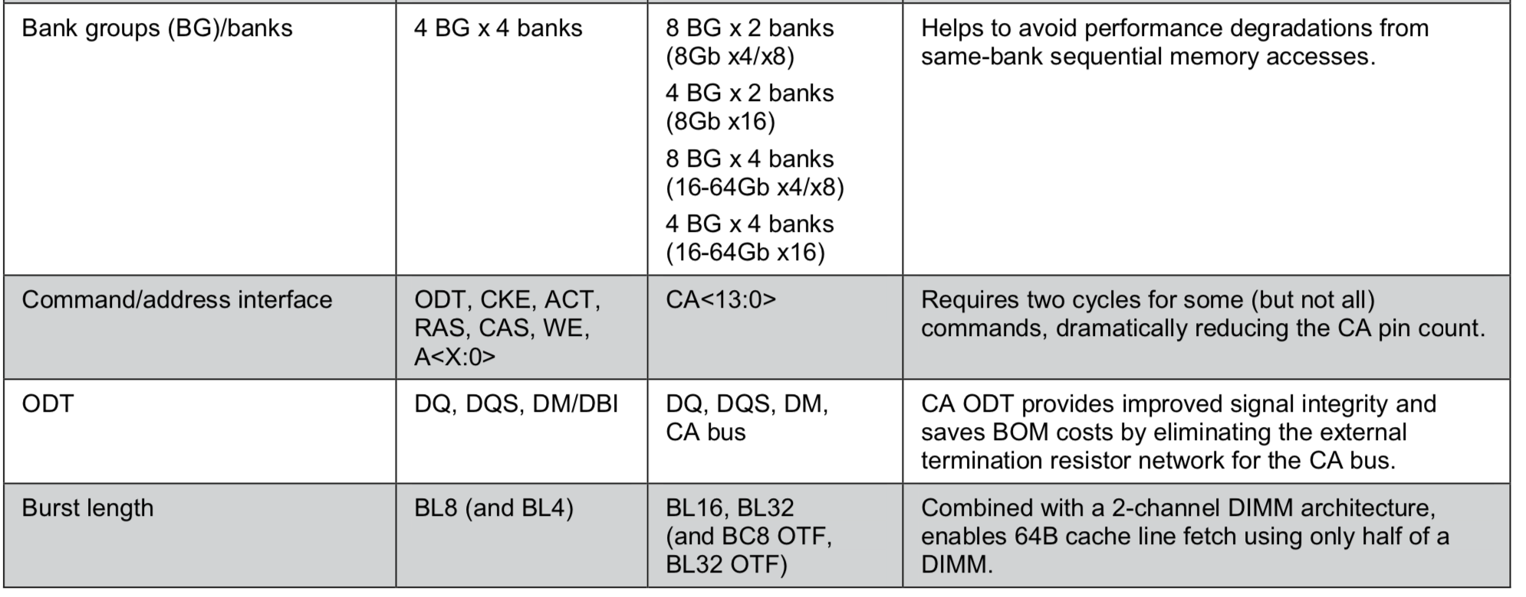
DDR4 → DDR5(Cont.)

Slide 22
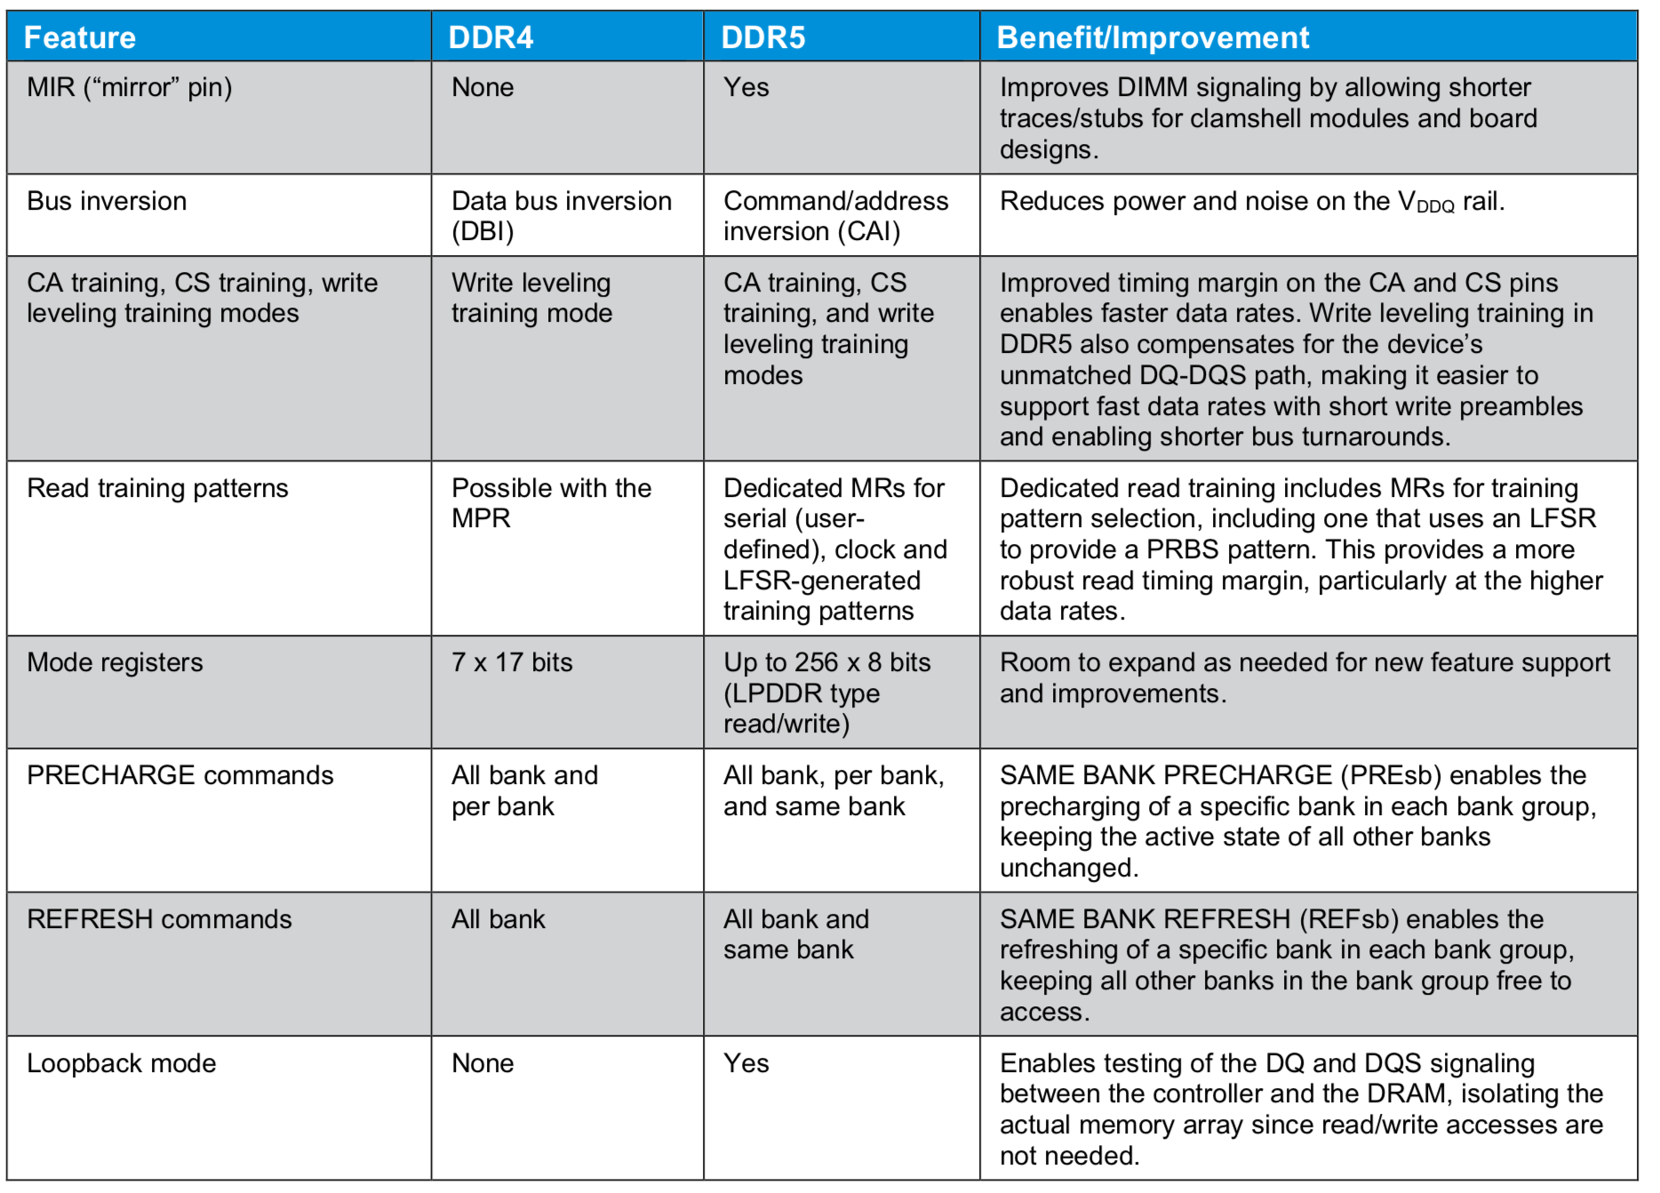
DDR4 → DDR5(Cont.)

Slide 23
LPDDR4 → LPDDR5

Slide 24
DRAM Pins

Slide 25
VDD1/VPP
Vdd1: Core Power: memory array power.
Vpp: DDR4 word line power.
A special high-voltage supply that supplies the potential and energy for altering the state of certain nonvolatile memory arrays. On some devices, the presence of VPP also acts as a program enable signal (P).
References:
JESD21-C, 1/97
For DDR4, JEDEC decided to introduce an external VRM that provides a 2.5v electrical high voltage for the word line (row access). Since the word line voltage is no longer pumped up from the DDR voltage (like it was for DDR3), the inefficiencies of pumping up the DDR voltage are gone, and instead you get power savings.

Slide 26
Why Dram Core/IO Power are isolate?
Since large amounts of current are sourced and sunk into the SDRAM during read and write operations, switching noise can be generated which may have an adverse effect on the memory array. Separate power inputs are provided for the I/O signals and the memory array, isolating the memory cells from possible data corruption.

Slide 27
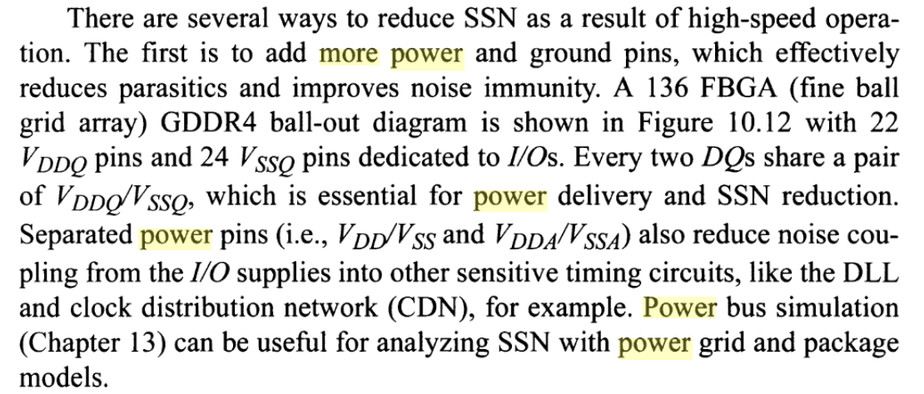
So many power pins?
VDD1/VDD2/VDDQ...

Slide 28
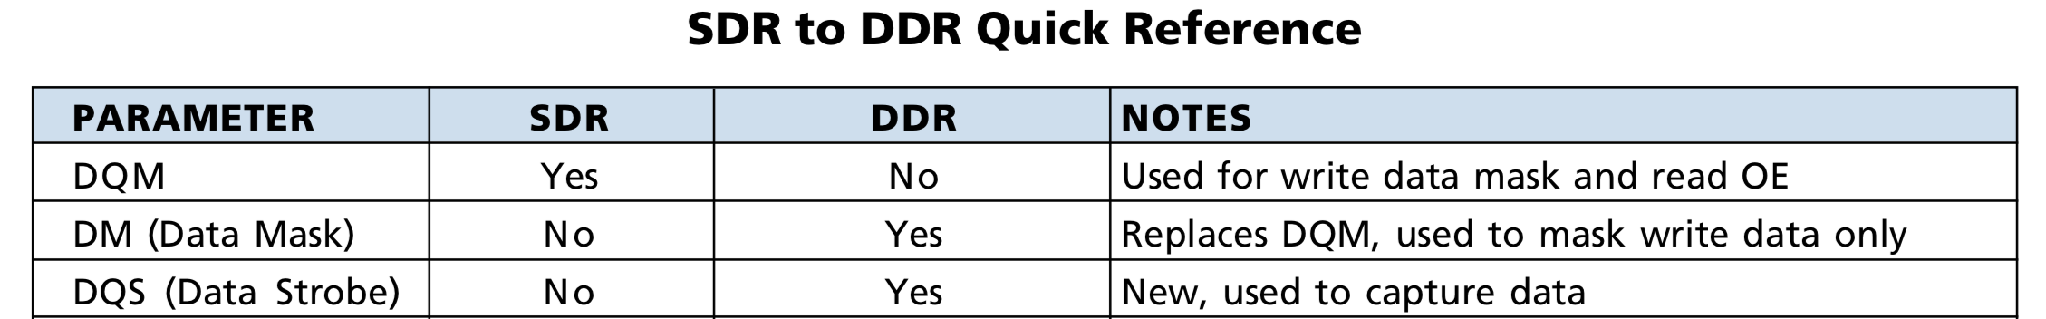
Clock Synchronous vs Source Synchronous
The SDR memory data interface is a fully synchronous design where the data is only captured on the positive clock edge.
The DDR memory data is a true source synchronous design, where the data is captured twice per clock cycle with a bidirectional data strobe.

Slide 29
Why CK is differential?
To increase accuracy caused by clock jitter, a differential clock was added to DDR. SDR devices use the midpoint of the rising clock edge to latch data and thus are exposed to drift. DDR uses the crossing point of CK and CK#. Using the crossing point instead of the midpoint helps negate the affects of jitter and increase margins.

Slide 30
CKE
CKE can be used to enter power down mode, which is a low power mode.
Power Down Mode:
Idle Power Down
Active Power Down.
If the dram is idle for a period, the controller can issue power down mode for low power.

Slide 31
SDR CA vs DDR CA
LPDDR3: DDR CA
DDR3/DDR4/LPDDR4: SDR CA
SDR CA:
easier to maintain good signal integrity.

Slide 32
Why are CA pin and DQ pin seperate?
The user interface of the memory controller is split into a command bus and a separate data bus. This split allows for maximum flexibility while ensuring the highest performance during data transactions.

Slide 33
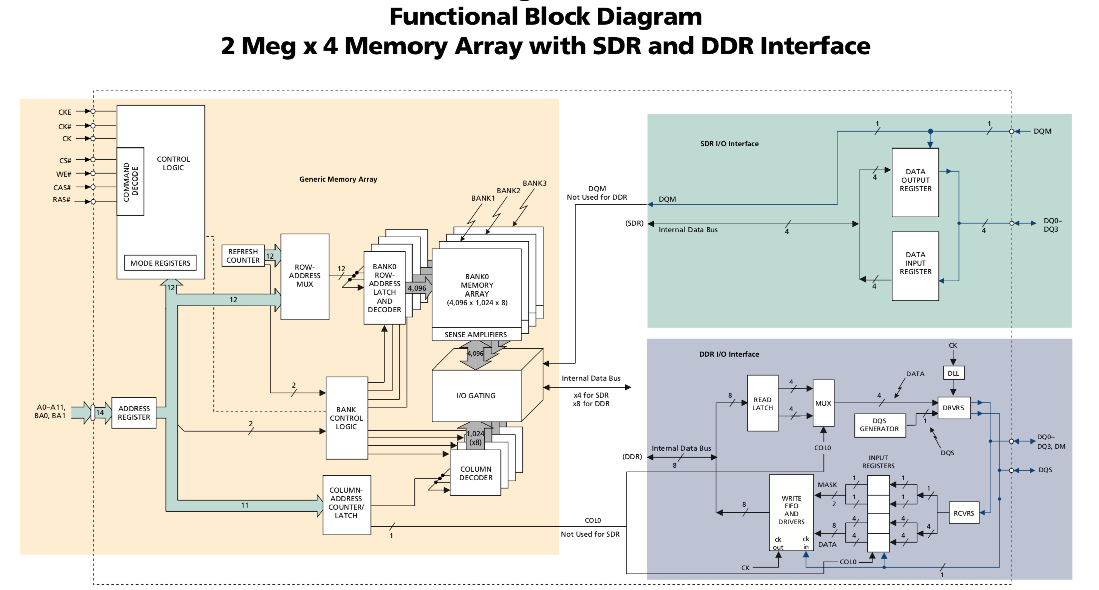
SDR DDR IO Interface

Slide 34
Where does DQS come from?
For higher data rate.
In a purely synchronous system, data output and capture are referenced to a common, free-running system clock. However, the maximum data rate for such a system is reached when the sum of output access time and flight time approaches the bit time (the reciprocal of the data rate). Although generating delayed clocks for early data launch and/or late data capture will allow for increased data rate, these techniques do not ac- count for the fact that the data valid window (or data eye) moves relative to any fixed clock signal, due to changes in temperature, voltage, or loading. So, to allow for even higher data rates, data strobe signals were added to DDR devices.

Slide 35
If no DQS...
Let's imagine time of flight for all signals is 1ns.
Situation with only one clk that is transmitted by the controller:
During write there is no problem. Data signals can be clocked to the CLK signal and everything is fine. If traces are length matched you can use timing tolerances tighter than the time of flight.
During read there is a problem. The controller must first transmit the clock to memory, where it arrives 1 ns later. Then the memory sends data bits to the controller and this takes another nanosecond. There is 2 ns skew, which limits how fast you can transmit.

Slide 36
Why 1 DQS matches 8 DQ?
If x32, we use:
32 DQS?
1 DQS?
Actually, for DQS/DQ matching, it’s different one by one. Other types of applications may use different strobe- to-data ratios. For example, servers using x72 DIMMs based on x4 components require controllers with one strobe per four bits, and controllers for graphics or com- munications applications might use one to four strobes per 32 bits.

Slide 37
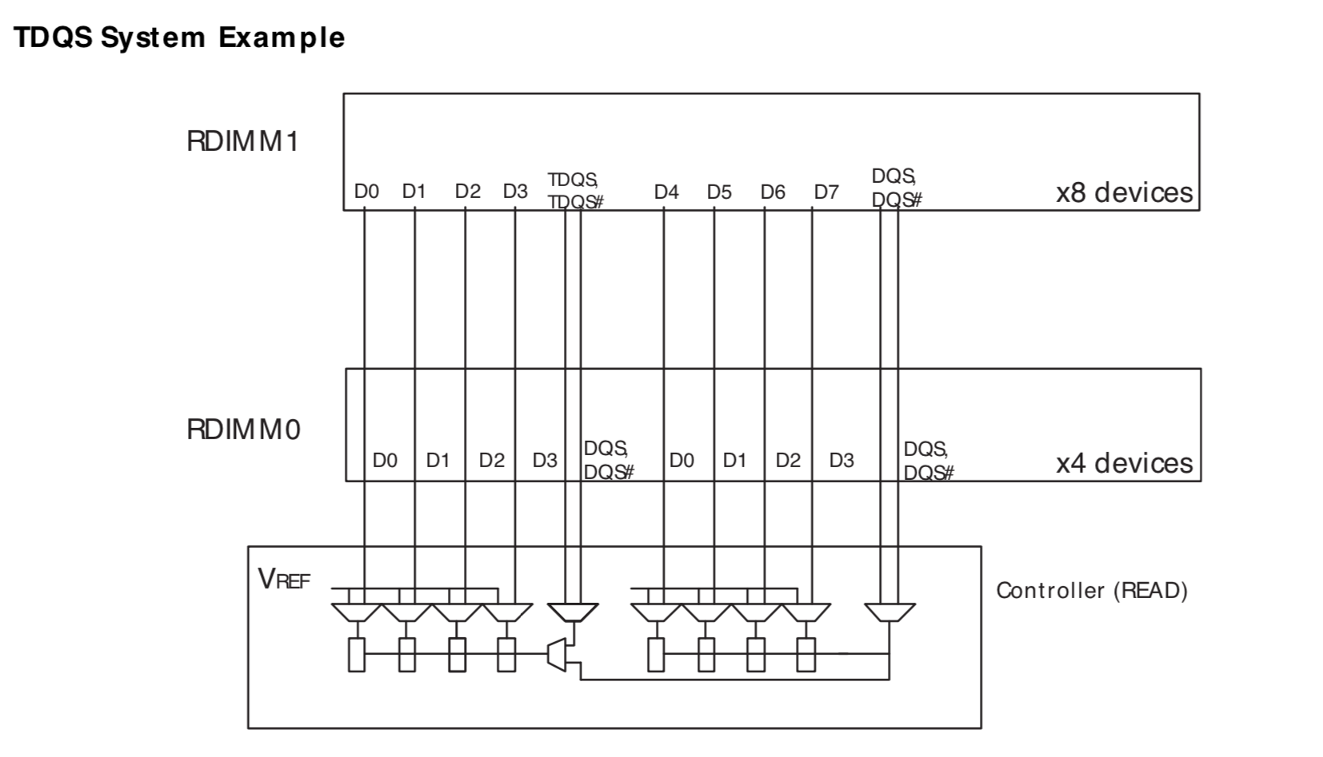
RDQS/TDQS
For x4 and x8 mixed design.

Slide 38
Why TDQS?
To simplify memory controller design for systems that simultaneously use both x4-based and x8-based registered DIMMs, DDR3 provides the termination data strobe (TDQS) function. DIMMs that are x8-based only require one DQ strobe pair (DQS/DQS#) for each 8-bit byte; x4-based DIMMs require a DQS pair for each 4-bit nibble (a total of four strobe lines). When these two different DIMM configurations are mixed within the same system, the loading of the DQS lines differs. These loading differences can cause signal integrity issues.
TDQS is similar to the RDQS function in DDR2, however, TDQS provides only termination. RDQS provides both termination and an output strobe.
Using the TDQS feature to reduce signal- integrity issues associated with mismatched DQS loading in combined x4-based/ x8-based systems.

Slide 39
DQS-DQ Edge Aligned vs Center Aligned
For easy control of the delay circuit, which can be done only by controller.
For READs, the data strobe signals are edge-aligned with the data signals, meaning that all data and data strobes are clocked out of the device by the same inter- nal clock signal, and all will transition at the outputs at nominally the same time. The controller will internally delay the received strobe to the center of the received data eye.
For WRITEs, the controller must provide the data strobes center-aligned relative to data. That is, strobe transitions occur nominally 90 degrees (relative to the clock frequency) out of phase with data transitions. The DRAM device uses internally matched routing for the strobes and data such that the strobes can be used directly to capture input data. Note that the reason READs and WRITEs use a different alignment scheme is so that the delay circuitry can be centralized in one place (the controller) and does not have to be repli- cated in every DRAM device in the system. This ap- proach is expected to be carried forward to future gen- erations of DDR to leverage the infrastructure now be- ing established.
Center Alignment creates the largest timing margin for the capture latches. Timing parameters, such as data setup (tS) and hold (tH).

Slide 40
Why DQ not differential?
DQ is a data signal, and can tolerate more skew than DQS.

Slide 41
Data Mask(DM)
Because dram burst length is often more than one byte, so, if we only write one byte(or less than the burst unit), the other bytes must be kept.
So, DM is a must.

Slide 42
Reset Pin
/RESET pin is introduced in DDR3 for system stability.
It prevents and handle illegal commands and/or unwanted states.
Why reset pin is effective on low?
Generally reset pin takes active low inputs . Main purpose of reset pin is to monitor the power fluctuations supplied to microcontroller . When ever power goes above / below threshold voltage reset circuitry triggers an active low signal on Reset pin.

Slide 43
Synchronous Reset vs Asynchronous Reset
Synchronous reset means reset is sampled with respect to clock. In other words, when reset is enabled, it will not be effective till the next active clock edge.
In asynchronous reset, reset is sampled independent of clk. That means, when reset is enabled it will be effective immediately and will not check or wait for the clock edges.

Slide 44
CPU Data Width == Dram Data Width?
Early PC, CPU Data Width is equal to dram data width.
Moden PC and moden phone don’t need they are equal.
Moden transfer protocol can handle the mismatch of data width, eg: AXI.

Slide 45
x4 x8 x16
Standard DRAMs support data-bus widths of 4 (x4), or 8 (x8), or 16 (x16) bits. Servers, cloud, and data-center applications use the x4 DRAMs as they allow a higher density on DIMMs, and enable RAS features that cut application downtime due to memory failures. The x8 and x16 DRAMs are less expensive and are commonly used in desktops and notebooks.
For x4:
Page size is small, maybe 512B, it can reduce power of activate.

Slide 46
The fullname of ZQ
ZQ calibration: calibration I/O impedance.
Impedance: aka as Z.
I/O: aka as Q.

Slide 47
Why is ZQ resister 240 ohm?
For easy to set to 34, 40, 60ohm...

Slide 48
Multi Channel
Multi channel can improve bandwidth because multi data transfer at the same time.
Multi channel means multi controller, every controller can work independently of each other.

Slide 49
Where does Rank come from?
The term rank was created and defined by JEDEC, the memory industry standards group, to distinguish between the number of memory banks on a module.
Rank: (中文) 把…分等级; 属于某等级; 排列; 使排成行.

Slide 50
Multi Rank
Increasing the number of ranks is mainly intended to increase the memory density per channel. Too many ranks in the channel can cause excessive loading and decrease the speed of the channel. Also some memory controllers have a maximum supported number of ranks.

Slide 51
Where does Bank come from?
Multiple banks are provided so we can be simultaneously working on different requests.
Bank: (中文)银行; (尤指赌博中的) 筹码; 赌本; 库存; 库.

Slide 52
Why 8 banks occurs in LP3/LP4?
2 banks or 4 banks exsit in early dram.
8 banks seems to be the best choice.
For random memory accesses, i.e., to different rows, each bank can only be accessed once per tRC. Let us suppose that the data burst interval is 8ns (1000MT/s) and tRC is 56ns. Then only one-seventh of the nominal data transfer rate can be sustained by one bank.
Notes:
http://www.qdpma.com/ServerSystems/DRAM.html

Slide 53
Sense Amplifier/Row buffer
Sense Amplifier’s another name is “Row Buffer”.
Why need Sense Amplifier?
Bit cells of SRAM are made very small to reduce the cost. Thus, turning bit-lines to logic 0 or 1 using small cells require much longer time.
To solve these issues both bit-lines are precharged to Vdd (logic 1). A single cell is electrically connected to bit-lines for a small time to make a small difference in voltages. Later, the sense amplifier senses that difference and convert that small difference to logic 1 and logic 0.
1T1C Structure : read from DRAM is destructive, so recover memory info is a must, sense amplifier occurs.

Slide 54
Row buffers act as a cache within DRAM
Row buffer hit: only move data from row buffer to pins.
Empty row buffer access: must first read arrays, then move data from row buffer to pins.
Row buffer conflict: must first writeback the existing row, then read new row, then move data to pins.

Slide 55
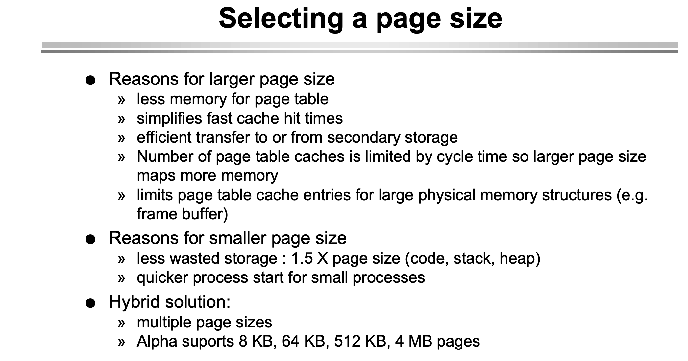
How to select Page Size?

Slide 56
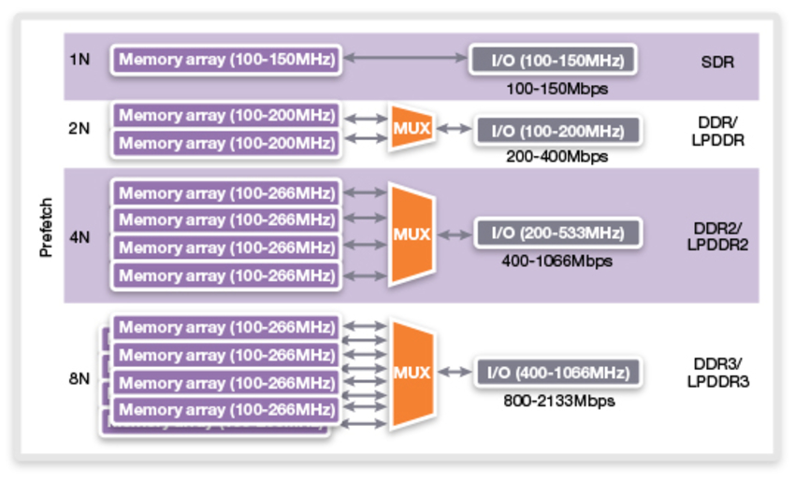
Prefetch
Prefetch is the term describing how many words of data are fetched every time a column command is performed with DDR memories.

Slide 57
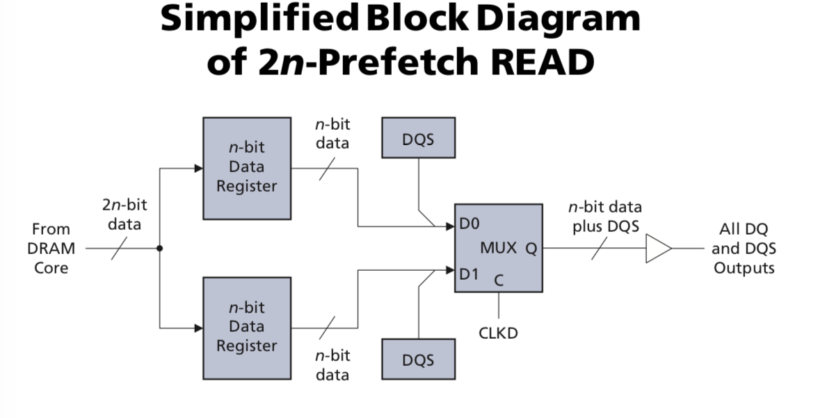
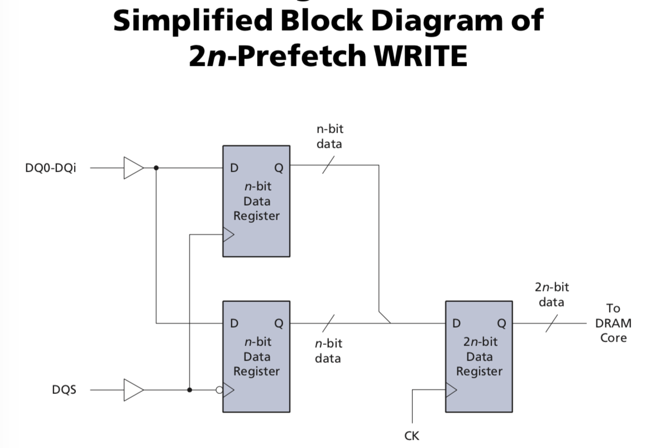
2n prefetch for READ and WRITE

Slide 58
Burst Length
Burst Length is often the multiple of prefetch size.
Burst Length should be equal or fraction of the size of cache line for better performance.
LP4(x16):
Prefetch Size: 16
Burst Length: 16 or 32
Cache Line(Arm(64)): 32 or 64 Bytes

Slide 59
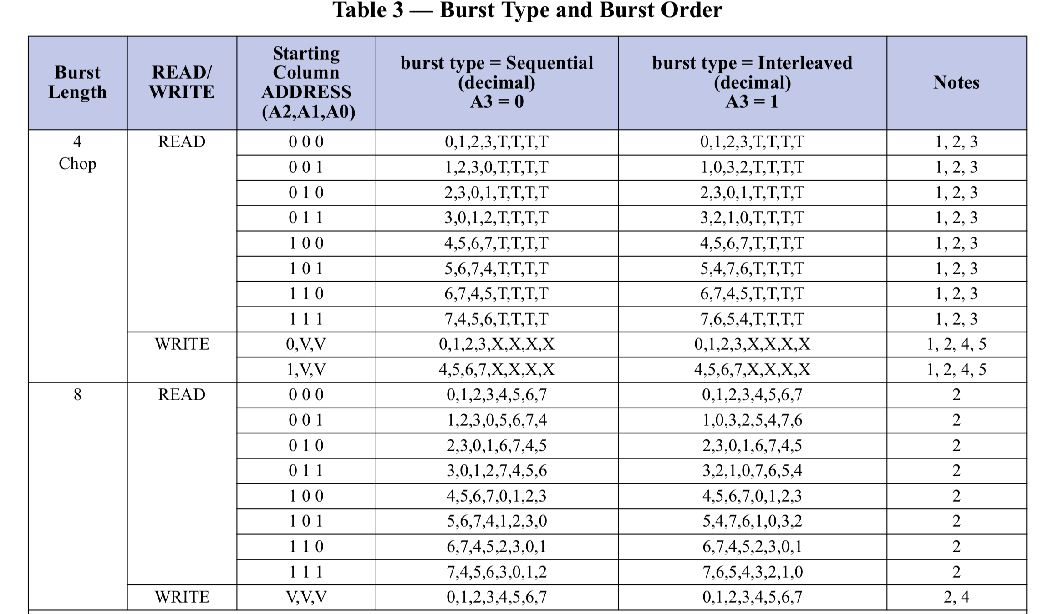
Burst Interleave
Burst Interleave is more efficient for some CPUs.

Slide 60
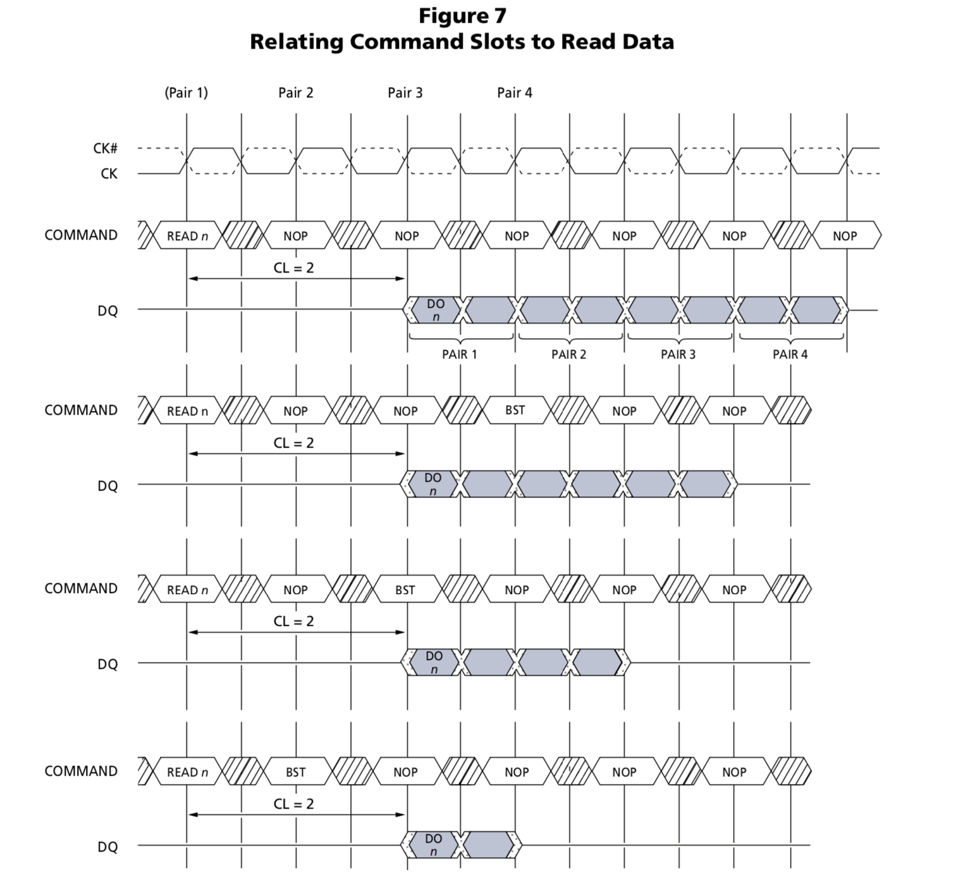
Burst Terminate
First occur in DDR.
An efficient pipeline of multiple column reads is already possible by simply sending multiple read commands spaced as closely as the desired burst length dictates.

Slide 61
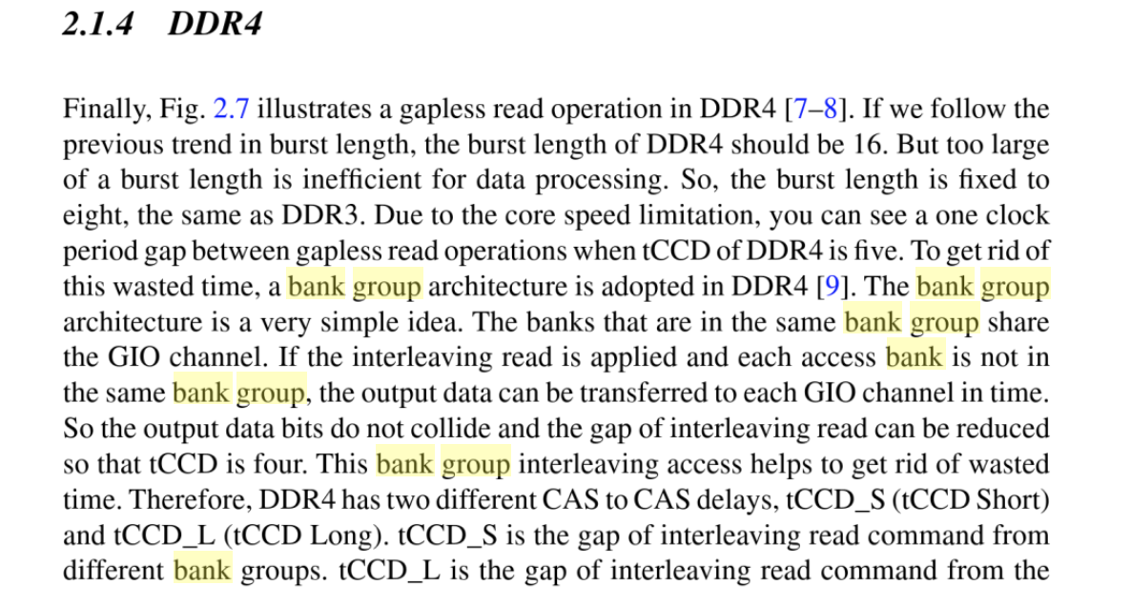
Where does Bank Group come from?
Notes:
https://books.google.com.hk/books?id=w9XBBAAAQBAJ&pg=PA87&lpg=PA87&dq=GDDR3+bank+group&source=bl&ots=otY1K8Ge8f&sig=ACfU3U13MPmgeUJffQiGqJxtn9mnrvaUZg&hl=en&sa=X&ved=2ahUKEwiOlu7Cu9znAhXPCuwKHRW-Bn4Q6AEwDnoECAoQAQ#v=onepage&q=GDDR3%20bank%20group&f=false

Slide 62
Bank Group
The bank groups feature used in DDR4 SDRAMs was borrowed from the GDDR5 graphics memories.
DDR4 introduces the concept of Bank Groups that allows the system designer to build interleaved memory arrays down to the individual device level. For smaller systems which may have only a single memory device, this Bank Group feature can offer substantial benefits.
For example, one bank group can receive a series of pipelined commands for its upcoming data transfers. Once the first Bank Group starts its actual data transfers, another Bank Group can be initialized with its separate set of pipelined commands. After the first Bank Group completes its data transfers, the second Bank Group can initiate its data transfers, since it has already received its set of pipelined commands. In many cases, this Bank Group command pipelining can significantly reduce the impact of memory device delays, such as shown below.

Slide 63
No Bank Group vs Bank Group

Slide 64
tCCD_L vs tCCD_S

Slide 65
Bank Interleave
Bank interleaving, which represents a significant advantage for applications accessing random data. Bank interleaving can be extremely effective for concurrent operations and can hide the timing overhead that is otherwise required for opening and closing individual banks.
OFF: Banks are not interleaved, and address will be decoded as bank-row-column. ON: Banks are interleaved, and address will be decoded as row-bank-column.

Slide 66
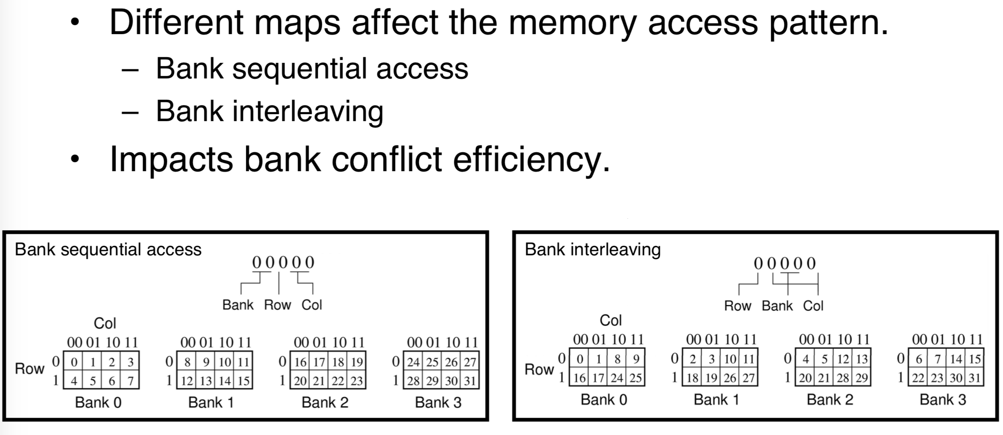
Advantage of bank interleave

Slide 67
BC4
Due to the 8n-prefetch architecture of DDR3, one burst must be 8 bits. Burst chop 4 (BC4) mode uses internal control signals to select only the first 4 bits of data to read or write. So, the entire command excution time for BL8 and BC4 is the same. If you are using a valid data cycle and total clock cycle to calculate efficiency, BC4 has a very low efficiency (lower than 50%). For a large data transfer and high-bandwidth application, BC4 is not suitable.
The only real benefit to the burst chop mechanism is that it allows better data bus utilization in dual rank memory systems, where the rank switching overhead may be shorter than the (same rank) burst chop idle time.

Slide 68
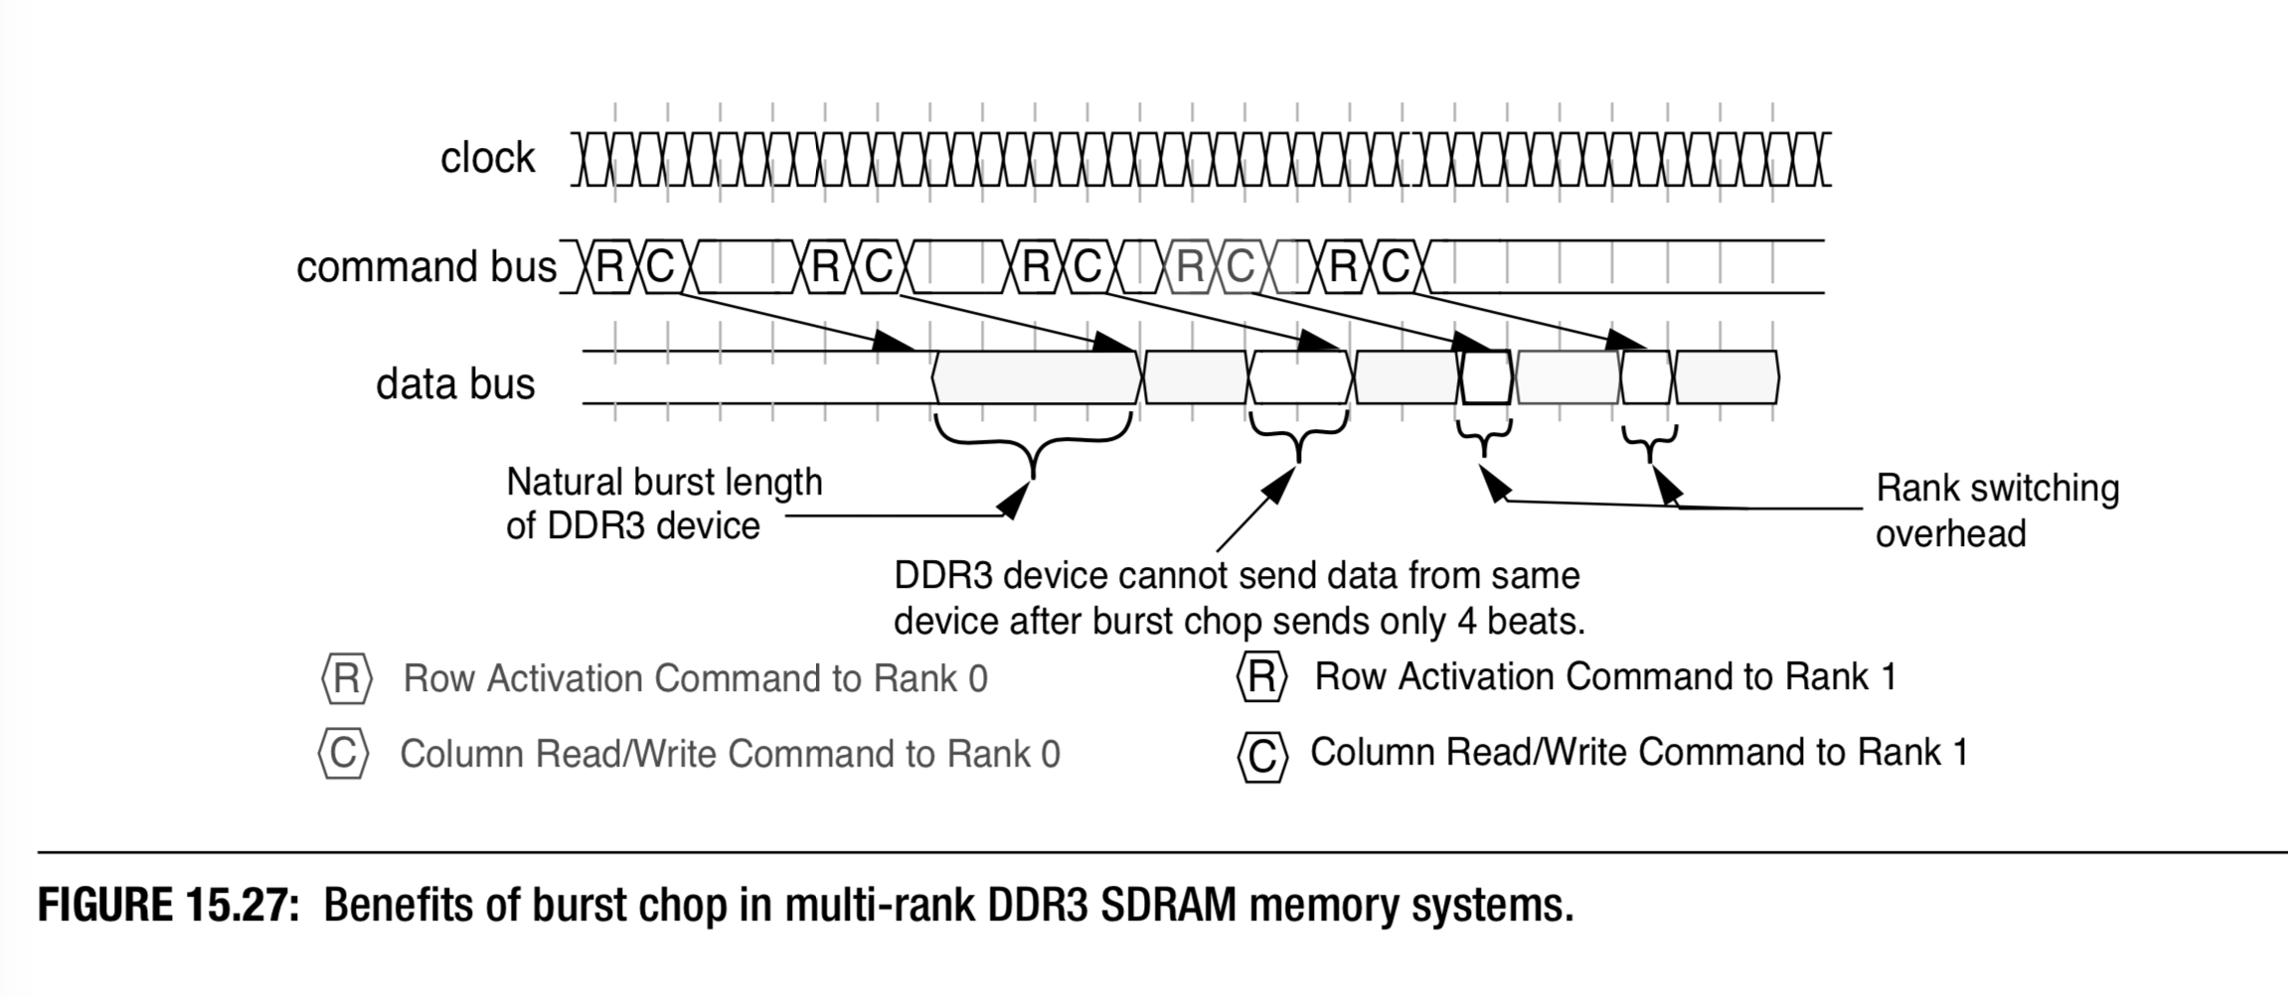
BC4 benifits in multi-rank system

Slide 69
FSP
Easy and fast when switch from one freq to another freq.
Used in LPDDR4 and LPDDR5.
This rapid switching is enabled by the addition of frequency set points (FSPs). LPDDR4 specifies two FSPs, which are copies of all the DRAM registers that store operating parameters which might need to be changed for operation at two different frequencies. Once both operating frequencies are trained and the parameters stored in each of the two corresponding FSPs, switching between the frequencies can be accomplished by a single mode register write. This reduces the latency for frequency changes and enables the system to operate at the optimal speed for the workload more often.
“It supports end-user flexibility,” noted Vuong. “Some designers like to run their devices as fast as they can and then put them to sleep. Others like to run at lower frequencies – and lower power – when possible. A process might take a little longer but that’s a trade-off they’re willing to make. We designed LPDDR4 to be flexible enough to allow the end-user to decide what they want to do.” With that flexibility comes superior performance – an LPDDR4 device, at a similar data rate, will consume less power than an LPDDR3 device.

Slide 70
DLL
DLL: Delay Locked Loop.
DDR3/DDR4 use DLL.
A DLL is used to maintain the timing relationship between a clock signal and an output data signal. A critical element of the DLL is the phase detector, which detects phase differences between the clock and output data.
LPDDR3/LPDDR4 don’t use DLL for low power.
CK to DQS is not synchronized.
How to fix the problem??

Slide 71
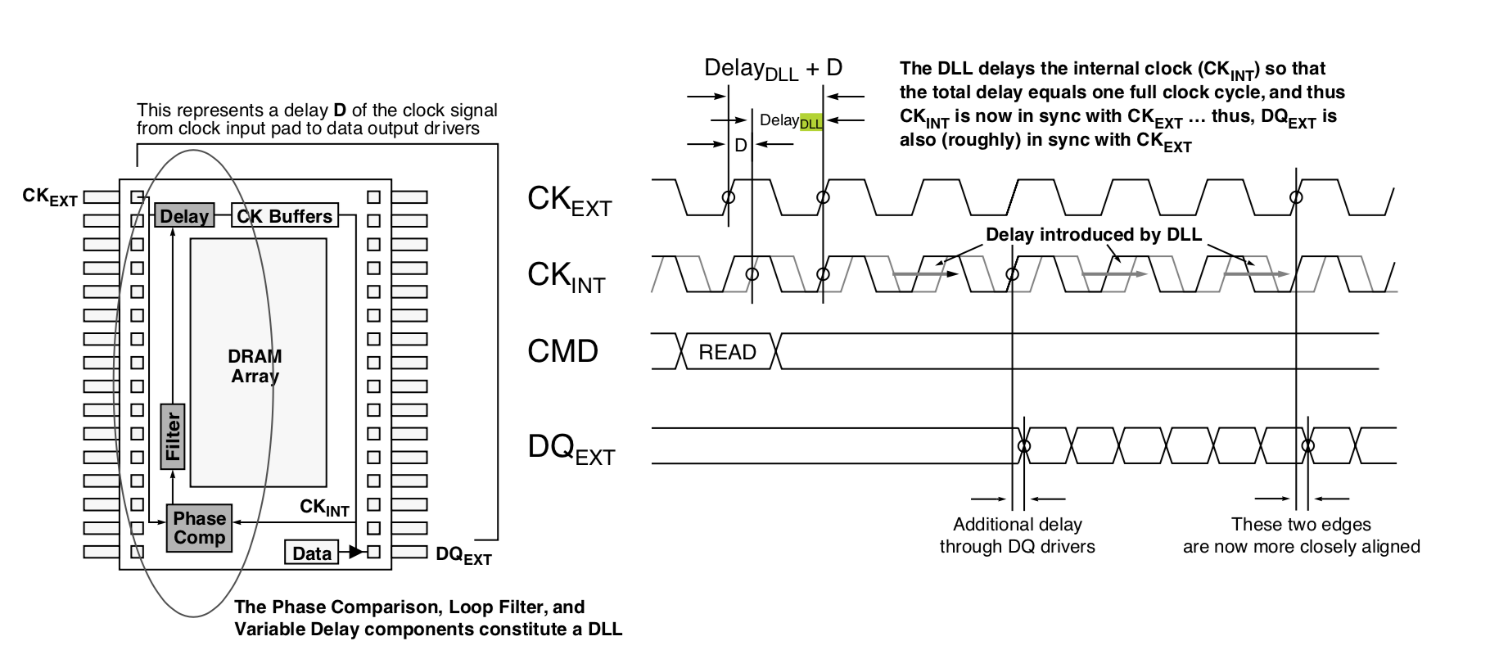
How DLL works?

Slide 72
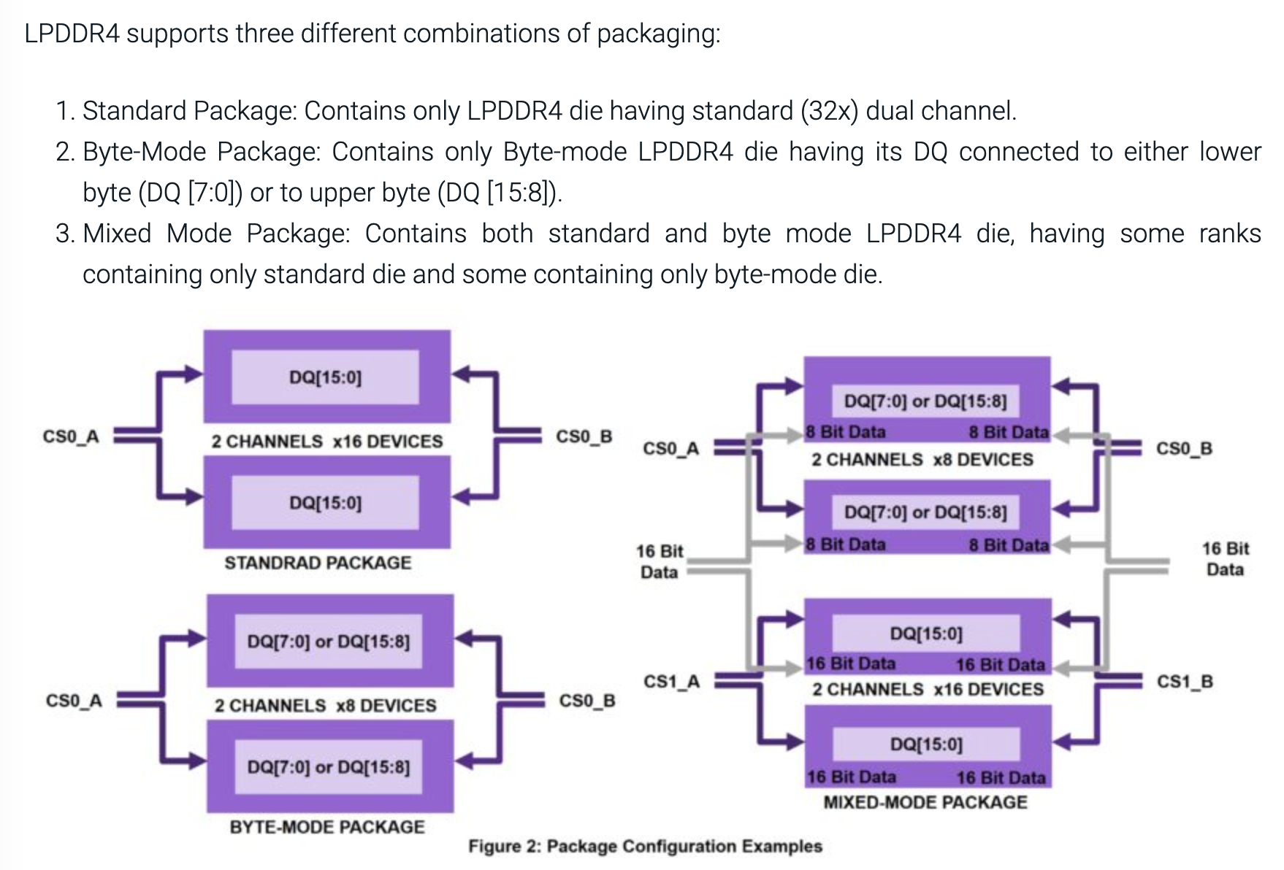
Byte Mode(LP4)
JESD21-C
LP4 x16 → 2 x 8

Slide 73
Why Dram Freq 2667 not 2777?
From history, the base clock is 100M or 133M.
Intel’s memory controller operates at either 100 or 133 MHz, producing multiples of 200 or 266.6MHz at integer ratios.
Dram freq is the multiple of the base clock.
2667 == 133.3333 * 20.

Slide 74
What’s the initialized data of DRAM?
Jedec Spec don’t specified the initialized data of dram, it’s meaningless.

Slide 75
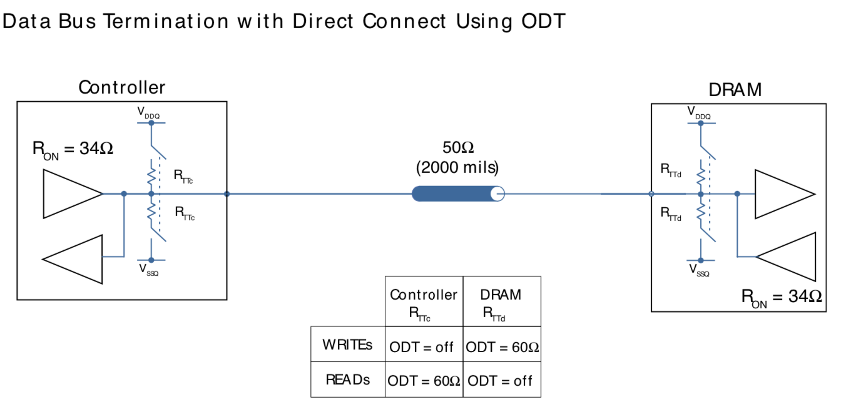
ODT

Slide 76
Dynamic ODT
Dynamic ODT allows a DDR3 SDRAM device to change termination values seamlessly between write commands issued to different modules. This feature is not available in DDR2 SDRAM systems, which require a bus idle time when changing termination values on the same device.
Dynamic ODT enables the DRAM to switch between high or low termination impedance without issuing a mode register set command. This is advantageous because it improves bus scheduling and decreases bus idle time.

Slide 77
Switch between RTT_NOM RTT_WR

Slide 78
ODT Park
PC4.
Improvements to the ODT protocol and a new Park Mode allow for a nominal termination and dynamic write termination without having to drive the ODT pin.
It’s often used in multi-rank system.

Slide 79
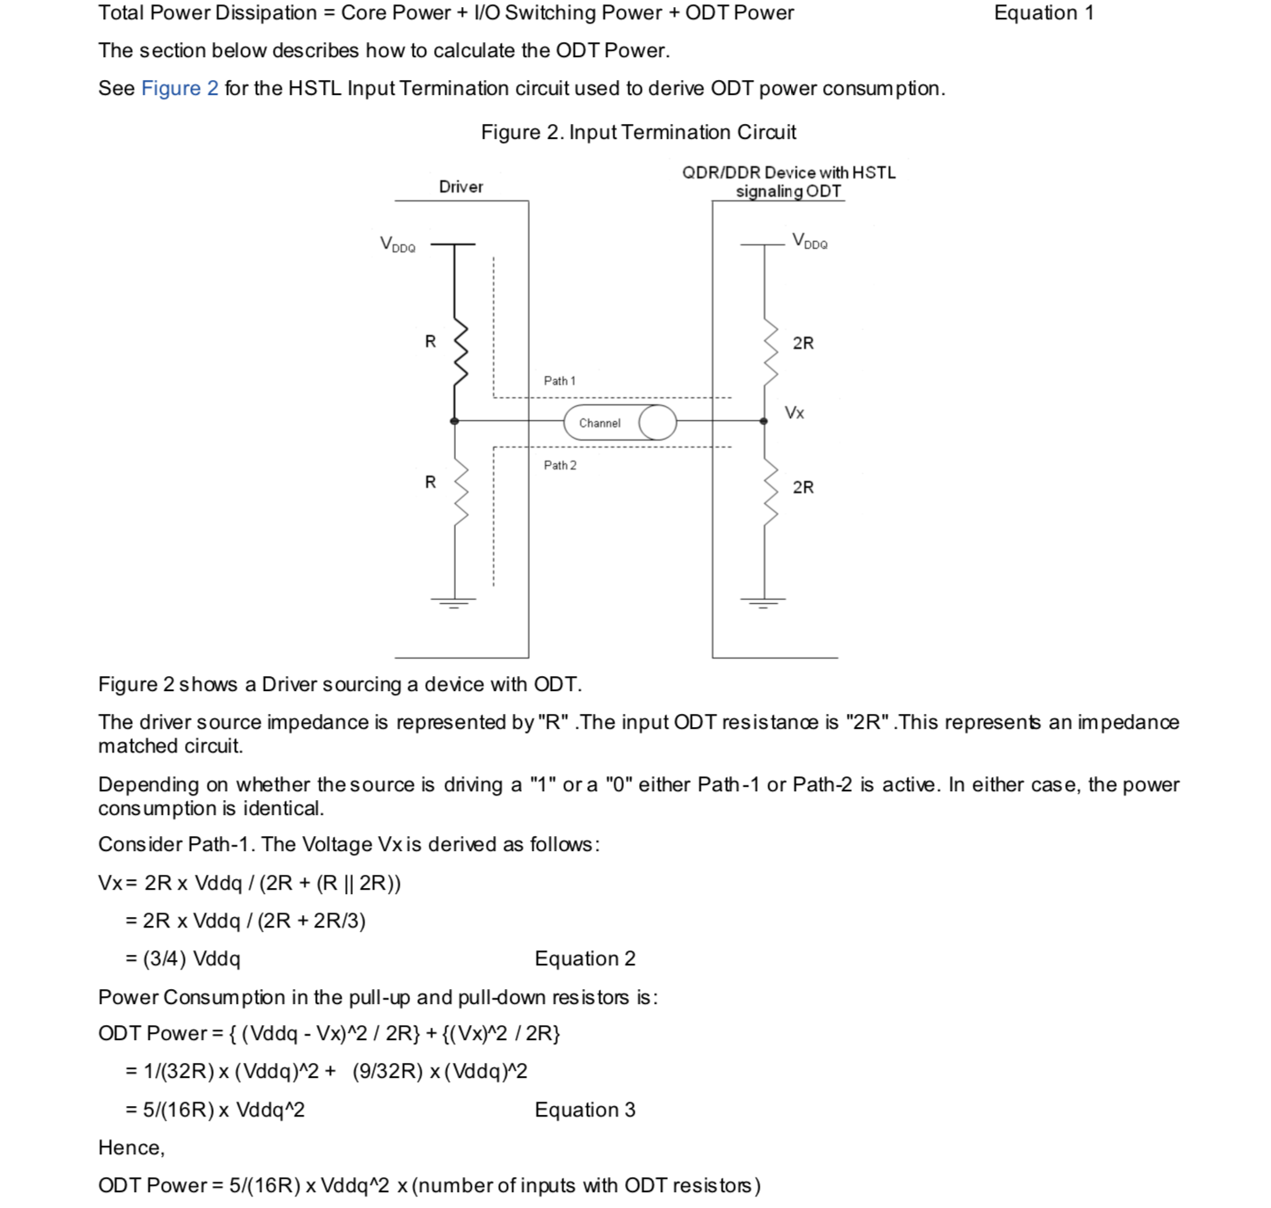
Power Consumption of ODT

Slide 80
Only one ODT of two ranks
Since the two ranks are physically very close on the memory, only one ODT signal is necessary for proper termination.
Non-Target ODT:
LP5 introduce the new ODT Mode, which can improve signal integraty.

Slide 81
VDDQ Termination vs VSSQ Termination
LP4: VSSQ Termination;
LVSTL
PC4: VDDQ Termination.
POD12

Slide 82
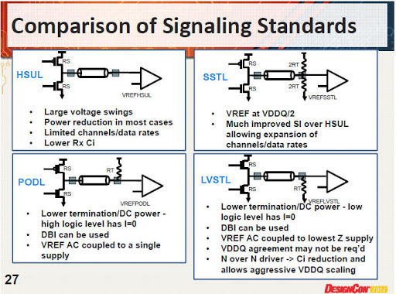
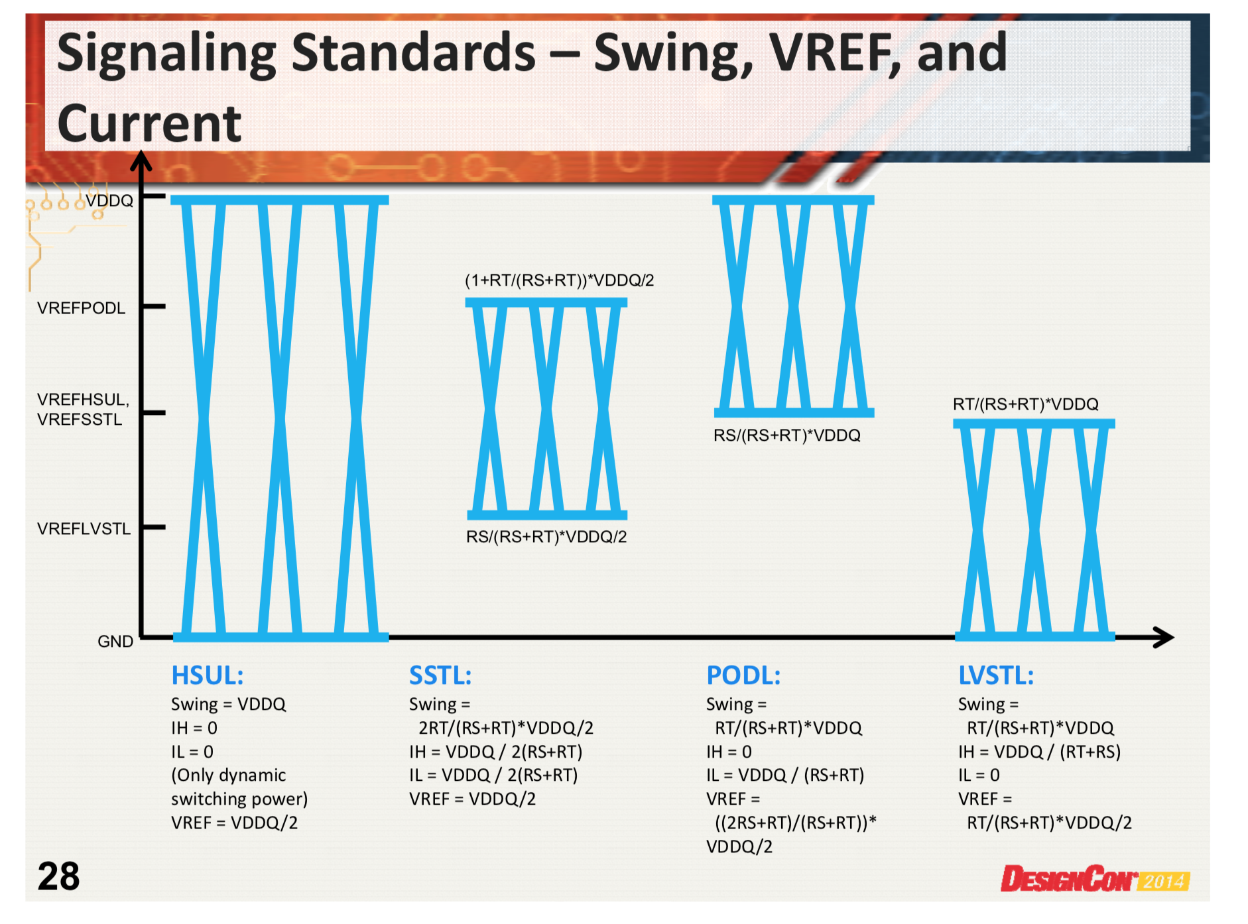
IO

Slide 83
A Die? B Die?
Different Types of Die.
Maybe 10nm, 20nm difference, or dram density, channel, rank...
A Die is better than B Die?
No, just die type.

Slide 84
DIMM
A DIMM or dual in-line memory module comprises a series of dynamic random-access memory integrated circuits. These modules are mounted on a printed circuit board and designed for use in personal computers, workstations and servers.
DIMM is used to assemble bigger data width and bigger density dram.

Slide 85
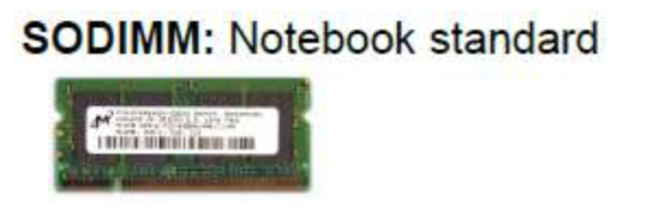
The Types of DIMM
Unbuffered DIMMs (UDIMMs)
Used mainly on desktop and laptop computers.
Although they run faster and cost less, UDIMMs aren’t as stable as registered memory. Commands go directly from the memory controller residing in the CPU to the memory module.
Fully-buffered DIMMs (FB-DIMMs)
Introduces an advanced memory buffer (AMB) between the memory controller and the memory module.
This enables an increase to the width of the memory without increasing the pin count of the memory controller beyond a feasible level.
Registered DIMMs (RDIMMs)
Also known as buffered memory, RDIMMs are often used in servers and other applications that require robustness and stability.
Load-reduced DIMMs (LR-DIMMs)
Optimize of RDIMMs, used in servers.
SO-DIMM
Small Outline DIMM
For smaller size of Notebook...

Slide 86
SIP
SiP (System in Package) integrates multiple functional chips, including processors, memory and other functional chips, into one package. SiP technology is not just an integrated circuit package containing multiple chips. SiP chip is an integrated circuit with one or more different functions. It may contain passive components and/or MEMS and be assembled in a single standard package to form a system or subsystem. The advantage of SiP packaging technology is the ability to integrate multiple IC, packaging and testing technologies, creating highly integrated products with optimized cost, scale and performance.

Slide 87
Lead-Free and RoHS
RoHS (Restriction of Hazardous Substances) is a European Union directive that restricts the use of lead, mercury, cadmium, chromium (VI), PBBs, and PBDEs in electrical and electronic equipment as of July 1, 2006.
Due to environmental concerns, the need for lead-free solutions in electronic components and systems is receiving increasing attention within the semiconductor and electronics industries. Maxim Integrated is committed to working with our customers to be able to offer products which meet their specific needs while complying with RoHS legislation.

Slide 88
Dram Features

Slide 89
Why dram needs training?
If layout is very good, the trace length and the length of all Pin’s layout are equal, dram signals are started and arrived at the same time, no need training.

Slide 90
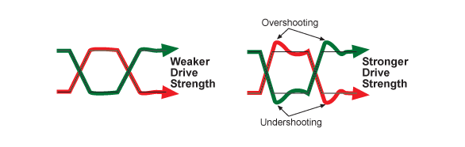
Drive Strength
DDR2: set drive strength by optional OCD.
After DDR3: set drive strength by ZQ Calibration.
The drive strength of an I/O specifies how much current we can drive and sink while maintaining the minimum Voh and Vol levels.

Slide 91
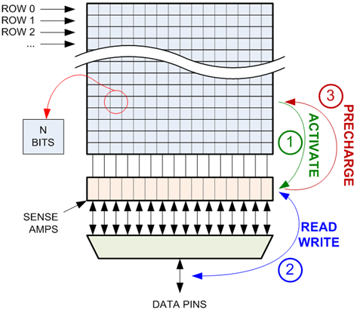
Precharge

Slide 92
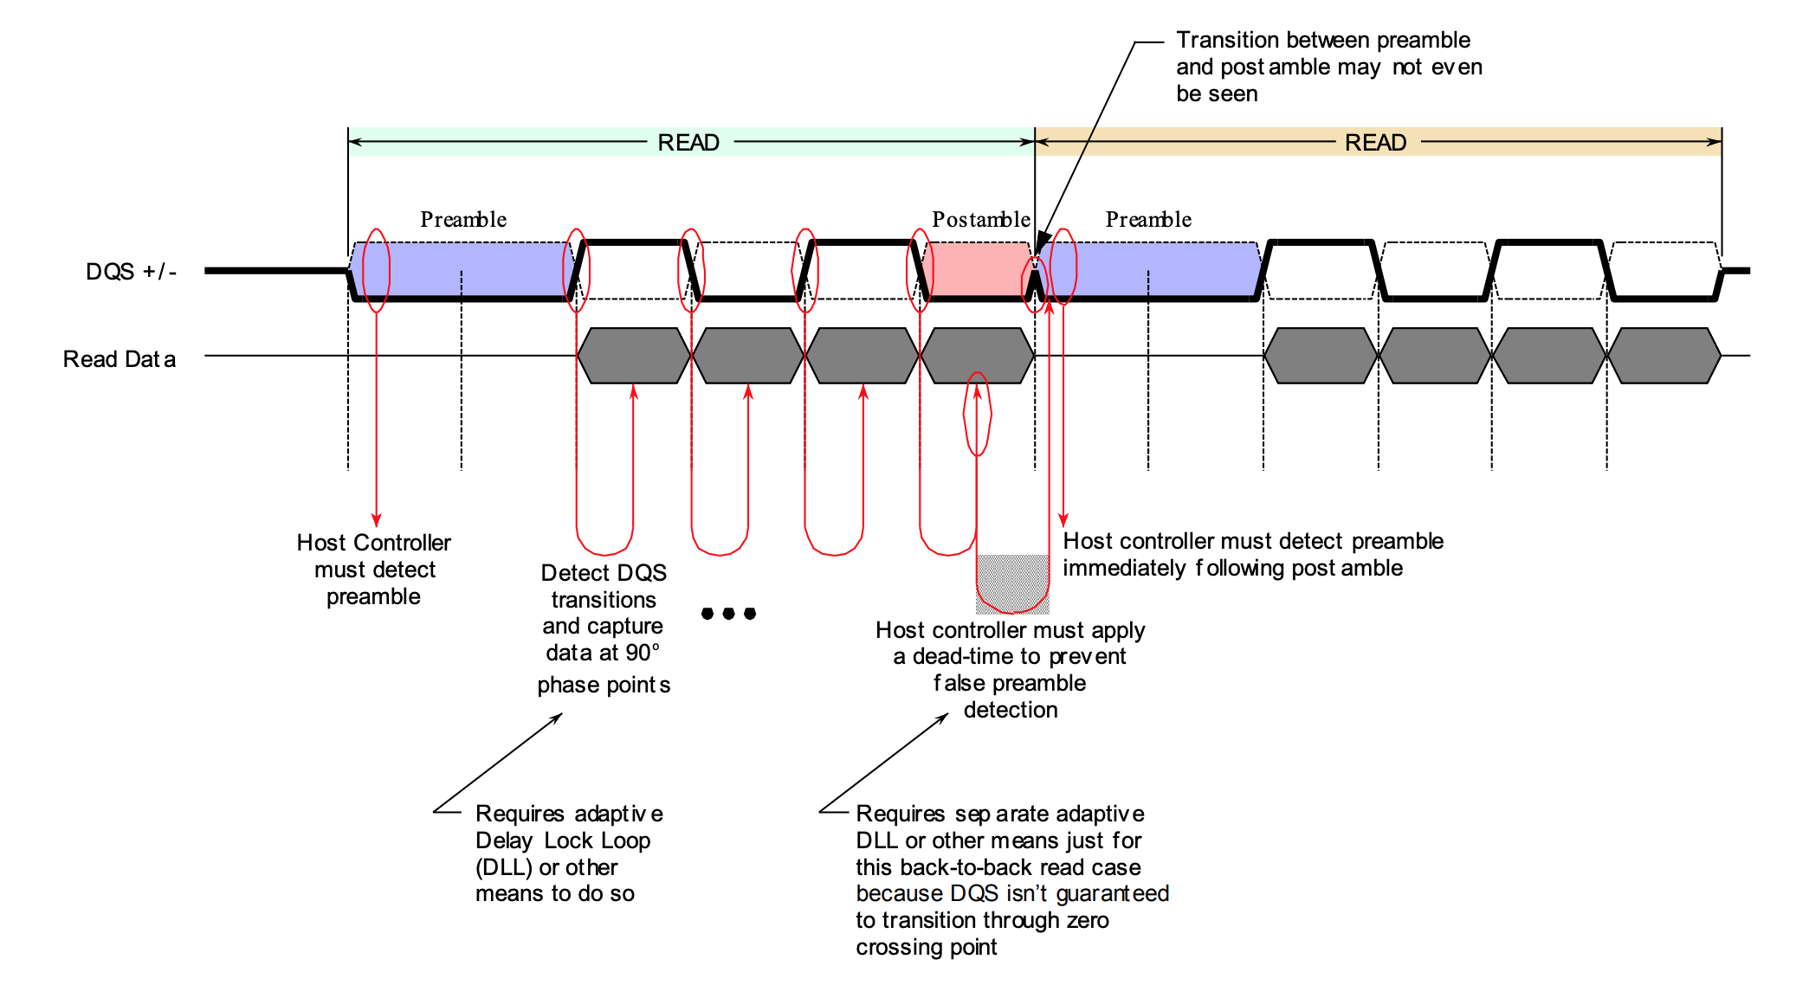
Read/Write preamble/postamble
Dram Controller or DRAM needs to check it for read or write correctly.
The preamble portion provides a timing window for the receiving device to enable its data capture circuitry while a known/valid level is present on the strobe signal, thus avoiding false triggers of the capture circuit.

Slide 93
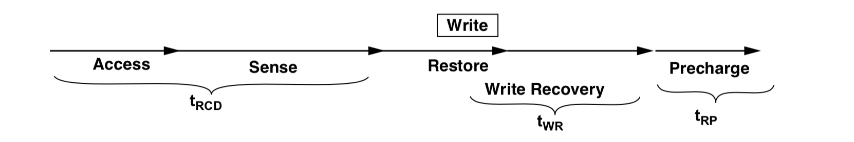
Write Recovery
The time interval between the termination of a write pulse and the initiation of a new cycle, this time interval being provided for the memory to recover from a write operation and operate correctly.
Write Recovery time:
The minimum time interval between the end of a write data burst and the start of a precharge command. Allows sense amplifiers to restore data to cells.

Slide 94
tFAW
Why Four Activate Window, not Five or Eight Activate Window?
If the consecutive read operations are falling each time in a different ROW within each bank than you have the activation problem kicking in each time. In order to avert a high current drain from the arrays you need to limit the number of consecutive bank activation over a rolling window of time.

Slide 95
Why 9 tREFI?
LP4:
tRFC min(32Gb) = 380ns, tREFI min = 3.904us.
3.904us / 380ns = 10.27.

Slide 96
Read Mask
SDR SDRAM uses Read Mask, it‘s phased out after DDR SDRAM.

Slide 97
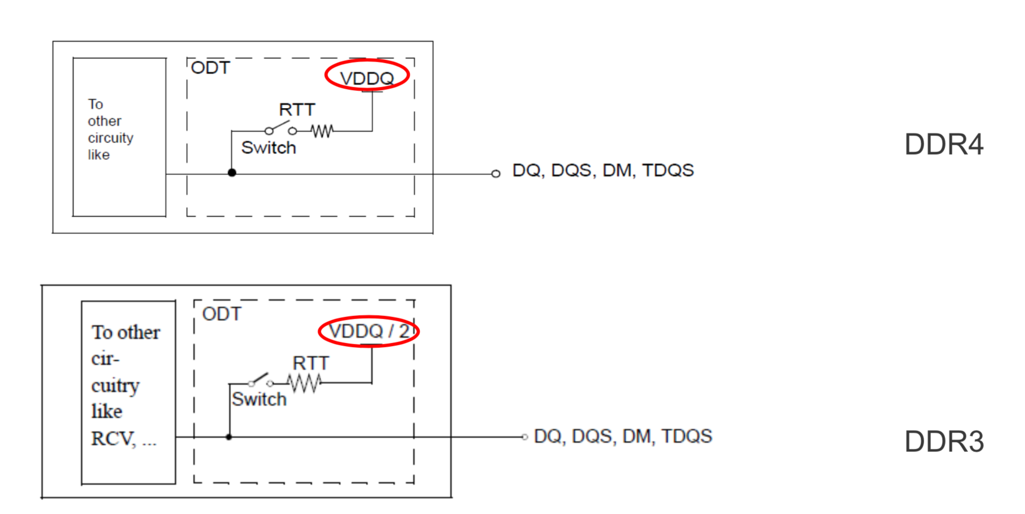
DBI
Data bus inversion (DBI) to help improve signal integrity while reducing power consumption, but it increases read or write latency.
Why DDR4/LPDDR4 supports DBI, DDR3/LPDDR3 don’t support?
Compare DDR4 and DDR3:

Slide 98
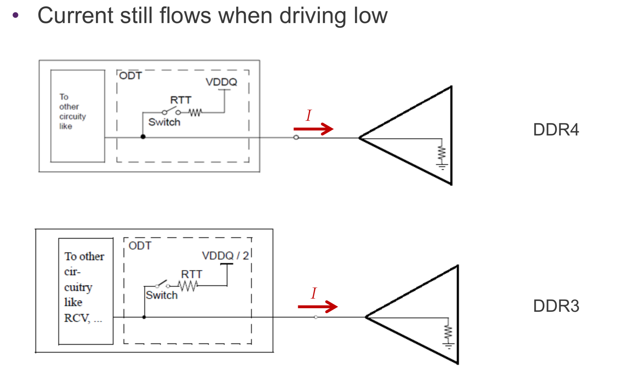
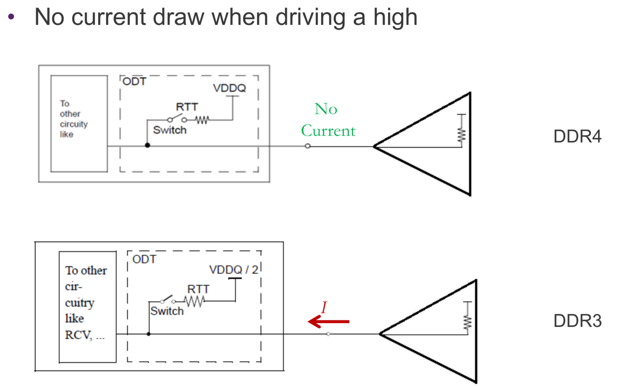
Driving low or driving high

Slide 99
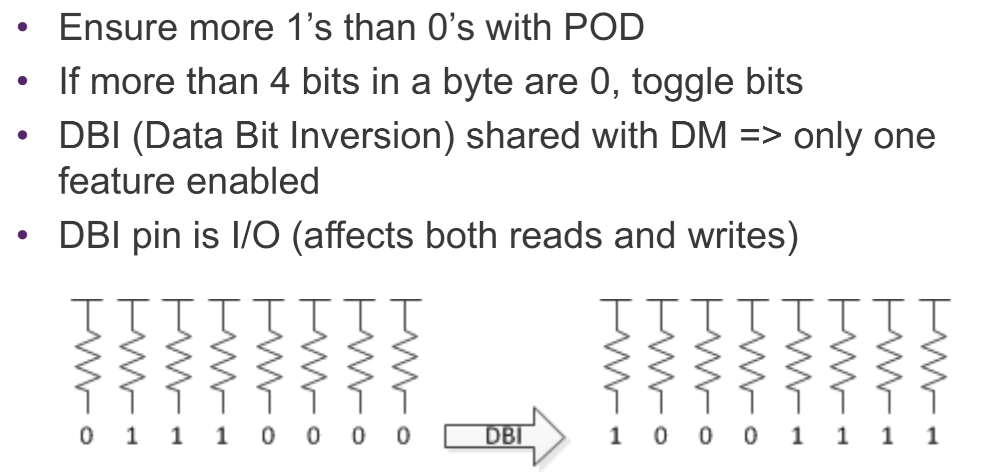
DDR4 DBI

Slide 100
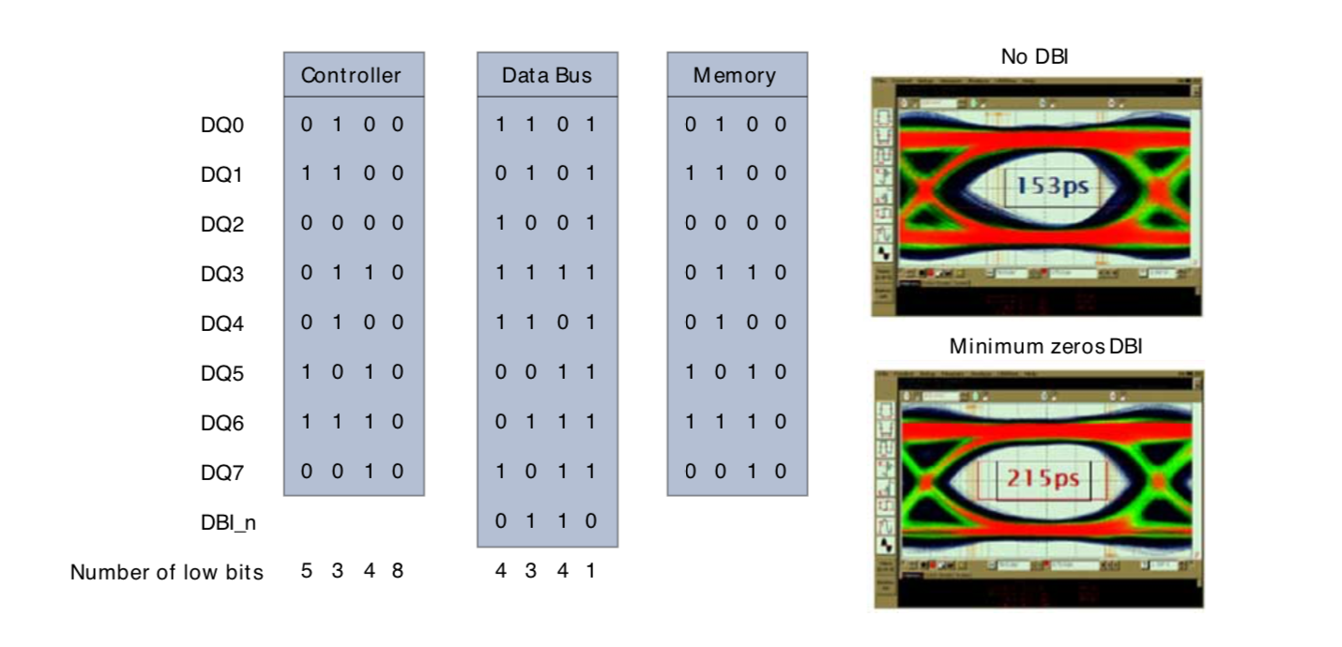
DBI for signal integraty

Slide 101
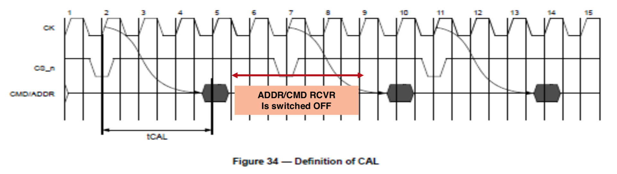
Command Address Latency(CAL)
DDR4 supports Command Address Latency, CAL, function as a power savings feature. CAL is the delay in clock cycles between CS_n and CMD/ADDR. CAL gives the DRAM time to enable the CMD/ADDR receivers before a command is issued. Once the command and the address are latched the receivers can be disabled.

Slide 102
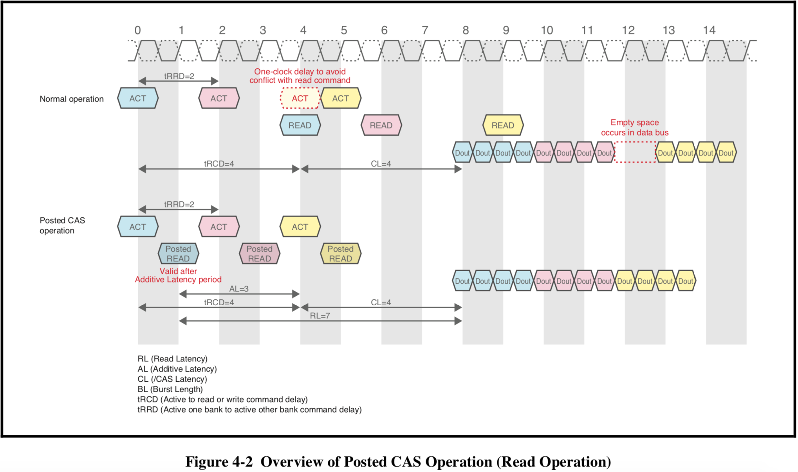
Additive Latency
First appear on DDR2.
Additive latency allows a read or write command to be issued immediately following the active command.
Allows ACTIVATE – READ/WRITE to be done together.

Slide 103
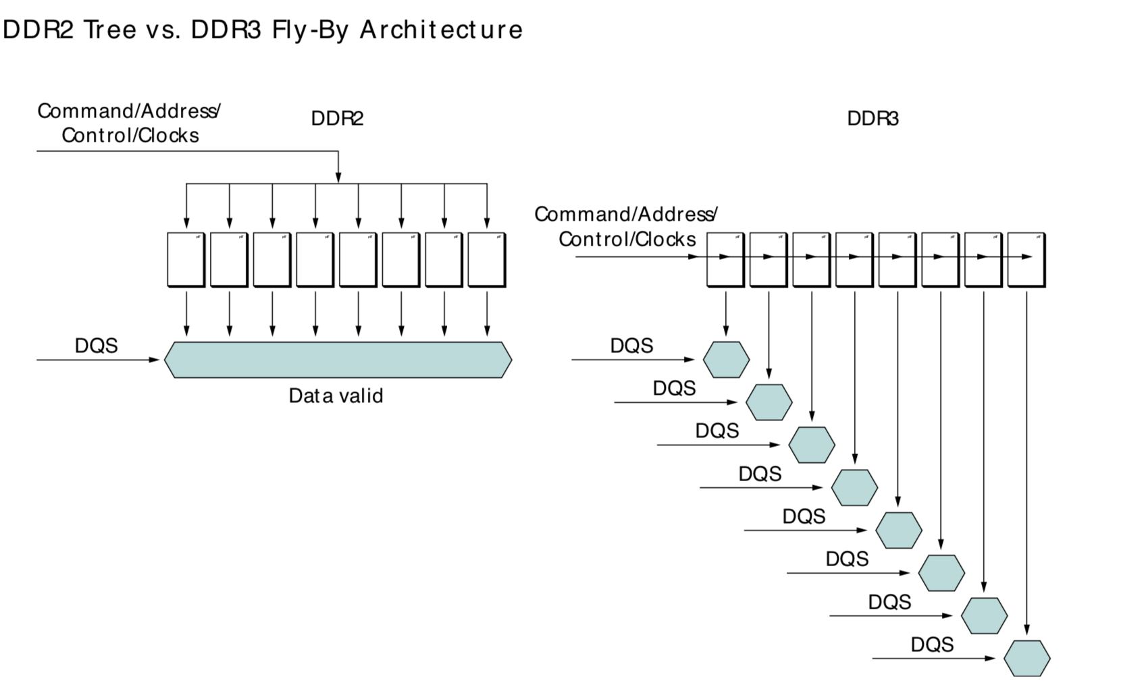
Fly-By Topology
DDR3 uses fly-by topology for CMD/ADD/CLK signals to improve signal quality.This causes flight time difference between DQ/DM/DQS and CMD/ADD/CLK. DDR3 has de-skew mechanism to compensate flight time difference.

Slide 104
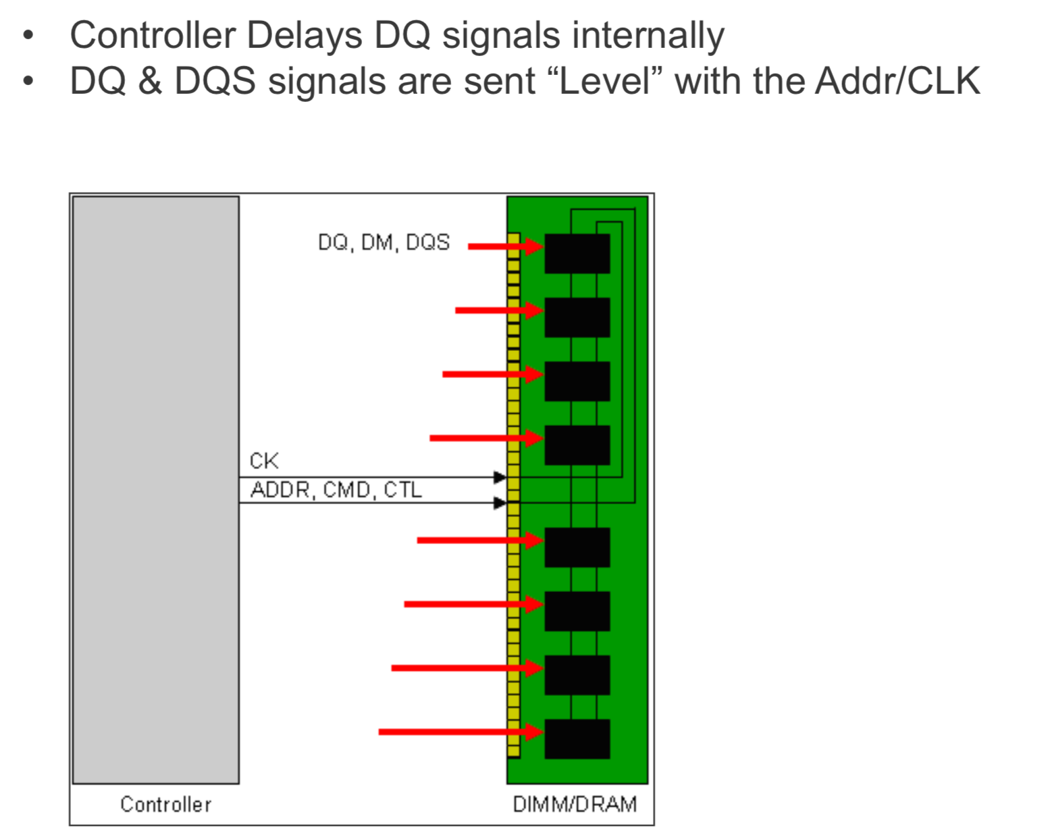
Write Leveling
During a write cycle, the skew between the clock and strobes is increased due to the fly-by topology. The write leveling will delay the strobe (and the corresponding data lanes) for each byte lane to reduce/compensate for this delay.

Slide 105
Read Leveling
DQ-DQS delay.
PC3:
Read leveling is a specification that adjusts the output skew from each DRAM on the controller side. Since DDR3 operates at high speed, correct data input may not be possible without timing adjustment.
In addition to the memory array, a ROM that retains specific data patterns is provided. The MPR function intended to assist the read leveling outputs data from the ROM.
The specific data patterns enable timing adjustment during READ operation. Note: To use MPR, the controller side must be compatible with MPR.

Slide 106
On Die ECC
DDR5/LPDDR5 support ECC.
Strengthens on-chip RAS; reduces burden on controller.
RAS improvements like on-die ECC reduce the system error correction burden by performing correction during READ commands prior to outputting the data from the DDR5 device. DDR5 SDRAM ECC is implemented as single error correction (SEC), pairing 128 data bits with 8 parity bits to form a 136-bit codeword that is stored in the DRAM during a WRITE command. During subsequent READ commands to that address, a syndrome will be calculated based on the 136 bits, correcting any single-bit errors that may occur.

Slide 107
Clock Stop Mode
The clock can be stopped if no DRAM operations are in progress that would be affected by this change. Any DRAM operation already in process must be completed before entering clock stop mode.
This feature increases power savings by having fewer transitions on the clock path. There are predominantly two methods used to achieve this according to Micron Technology:
Changing the clock frequency when the data transfers require a different rate of speed, or,
Holding CKE HIGH, with CK LOW and CK HIGH for the full duration of Clock Stop Mode
The method being used is based on an individual product’s requirements. Mobile DDR memory can change the clock frequency during operation, but this is only allowed when all the timing and memory refreshing requirements are met.
According to JEDEC, the clock can even be stopped completely under the following conditions:
The last command (ACTIVE, READ, WRITE, PRECHARGE, AUTO REFRESH or MODE REGISTER SET) has executed to completion, including any data-out during read bursts; the number of clock pulses per access command depends on the device’s AC timing parameters and the clock frequency.
The related timing conditions (tRCD, tWR, tRP, tRFC, tMRD) have been met.
CKE is held High.

Slide 108
Clock Stop Mode(Cont.)
PC3:
The input clock frequency can be changed from one stable clock rate to another stable clock rate under two conditions: (1) Self-Refresh mode and (2) Precharge Power-down mode. Outside of these two modes, it is illegal to change the clock frequency.

Slide 109
Test Mode
PC3:
The normal operating mode is selected by MR0 (bit A7 = 0) and all other bits set to the desired values shown in Figure 2.3.2. Programming bit A7 to a ‘1’ places the DDR3 SDRAM into a test mode that is only used by the DRAM Manufacturer and should NOT be used. No operations or functionality is specified if A7 = 1.

Slide 110
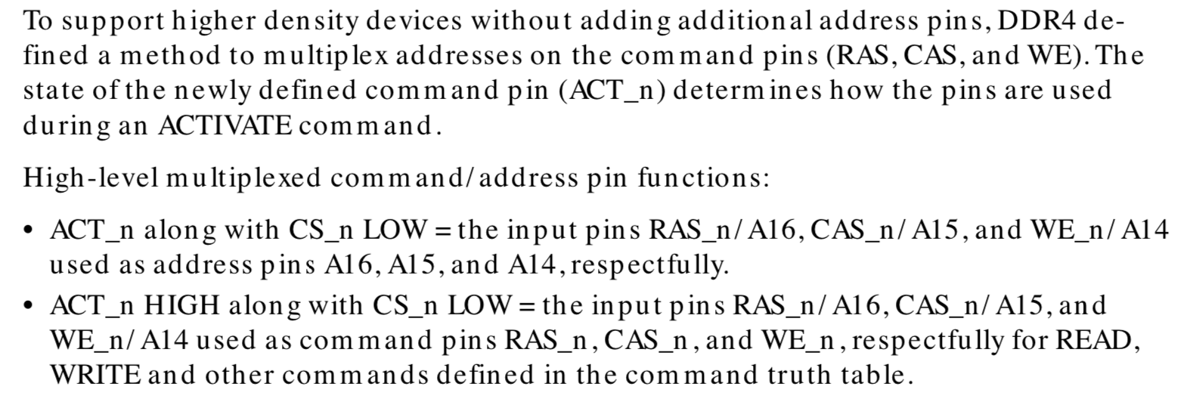
Multiplexed Command Pins
PC4.

Slide 111
Connectivity Test Mode
Aka as “Boundary Scan Test”.
PC4: TEN pin.
JEDEC organization has defined Connectivity Test Mode for DDR4 memories in order to speed up testing of electrical continuity of pin interconnection between host device and memory.
DDR4 Connectivity tester perform an exhaustive test covering data and address buses as well as memory control signals following the JEDEC standard.
The comprehensive set of test patterns guarantees detection of static defects (shorts, opens, bridging faults) on memory interconnection lines.
Memory controller can test and detect connectivity faults without needing to go through DRAM initialization sequencing.

Slide 112
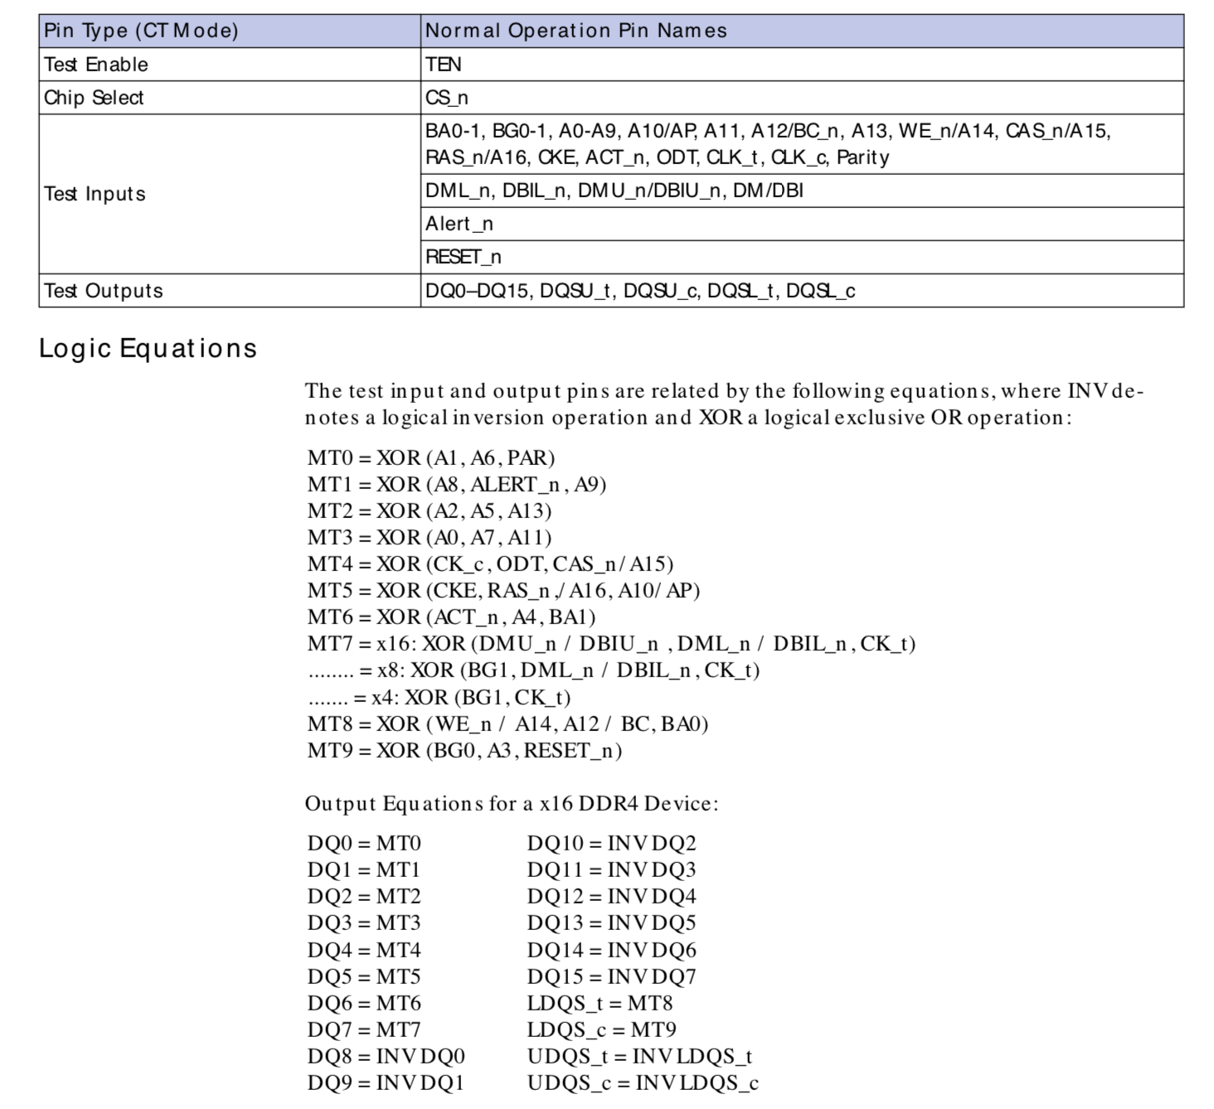
Connectivity Test Mode Pins

Slide 113
Per DRAM Addressability
PC4.
While in DDR3 it was only possible to configure all DRAMs on a Rank in parallel now it is possible to configure single DRAMs by qualifying configuration commands by DQ0. Don’t understand this feature wrong! This is not for reading out data of a single DRAM, but for configuring ODT and Vref levels per DRAM.

Slide 114
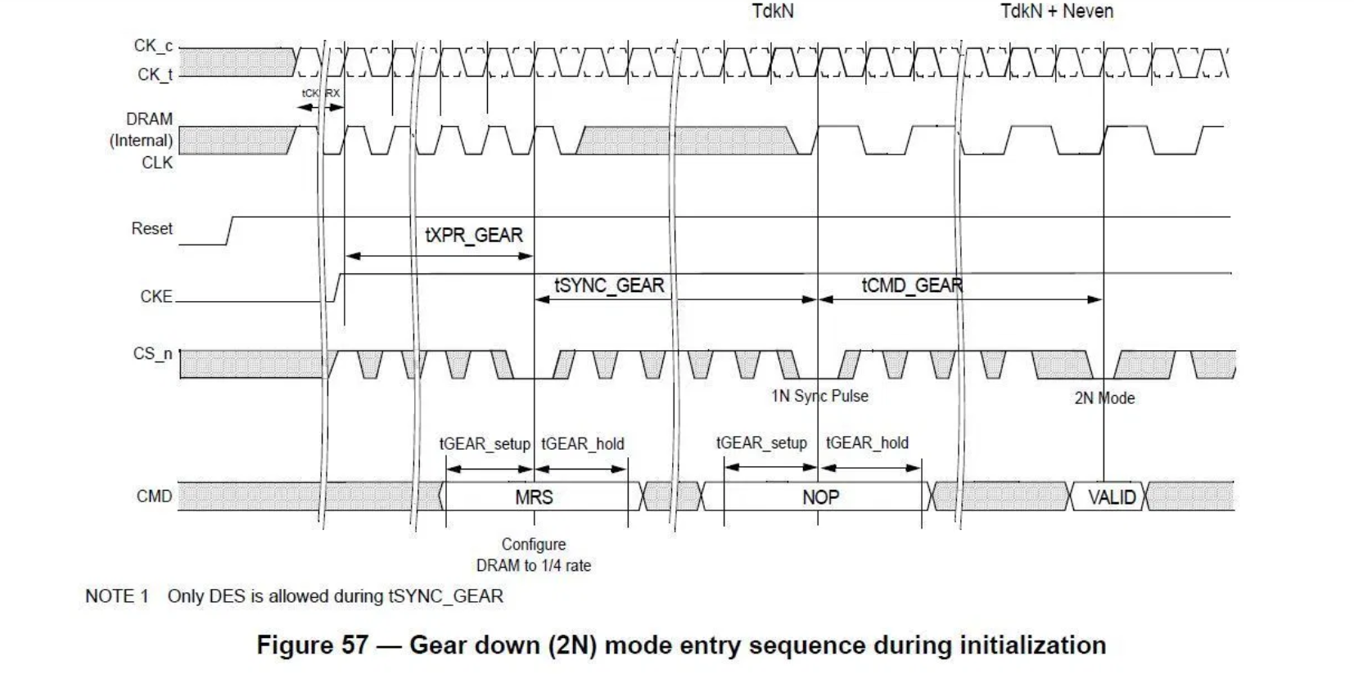
Gear Down Mode
PC4.
Gear-down mode, allows the DRAM Address/Command and Control bus to use every other rising clock of the DDR4 Memory bus clock.
Normally: CA = ½ Data Rate;
Gear Down Mode: ¼ Data Rate.
This conservative latching
can potentially allow for
higher clockspeeds, broader compatibility, and better stability—good
for the average user.

Slide 115
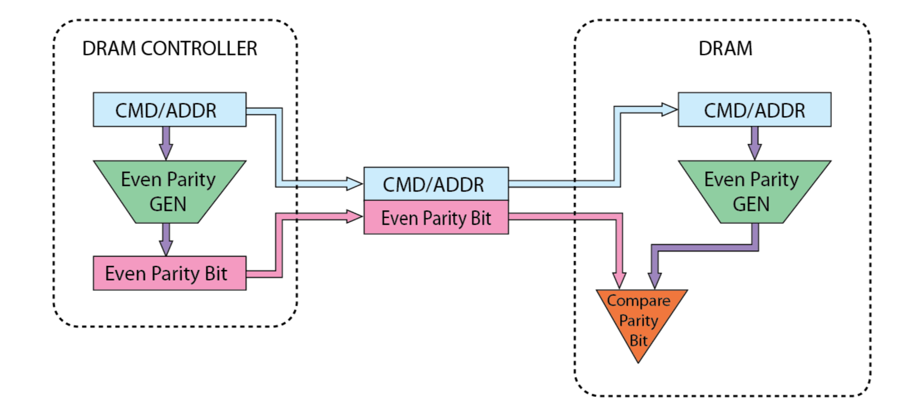
Command/Address Parity
PC4:
[A2:A0] of MR5 are defined to enable or disable C/A Parity in the DRAM. The default state of the C/A Parity bits is disabled.

Slide 116
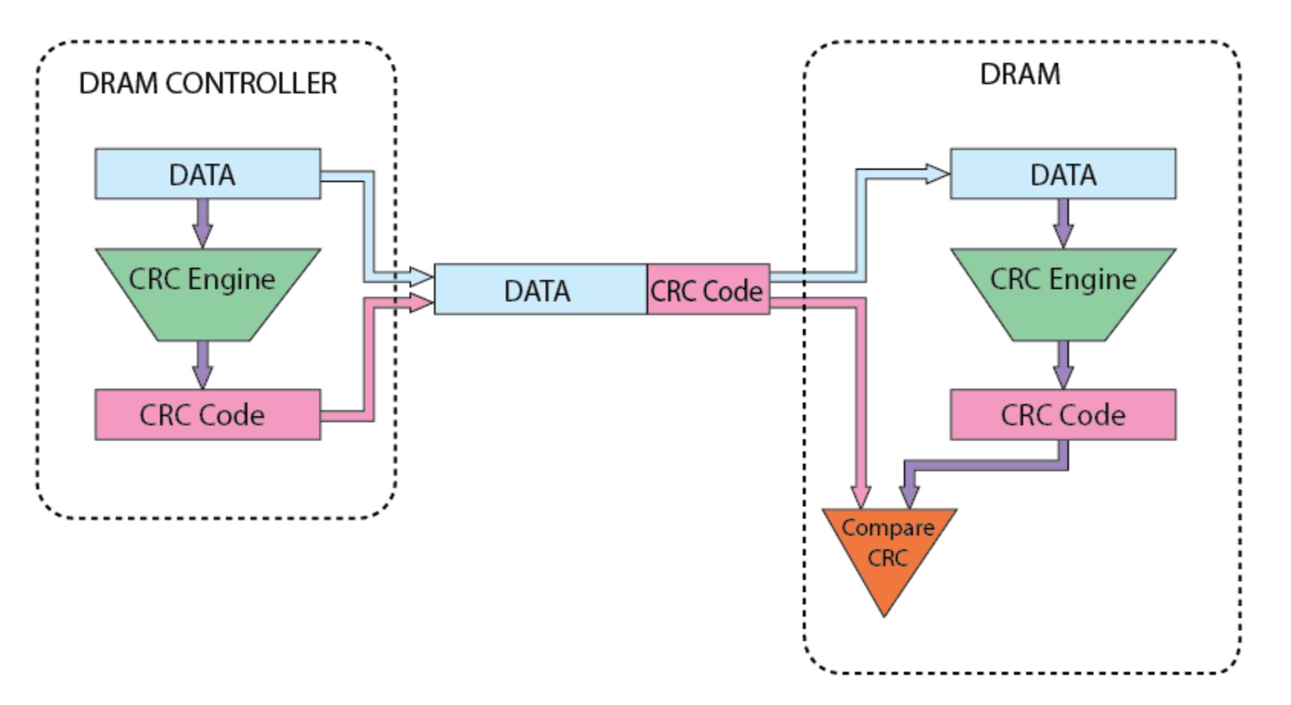
Write CRC
PC4:
CRC error detection provides real-time error detection on the DDR4 data bus, improving system reliability during WRITE operations. DDR4 uses an 8-bit CRC header error control: X8+X2+X+1 (ATM-8 HEC).

Slide 117
ALERT_N Pin
PC4.
Alert_n – Active low output signal that indicates an error event for both the C/A Parity Mode and the CRC Data Mode.
Based on the checksum, the controller can decide if the data or the returned CRC was transmitted in error and take appropriate measures.

Slide 118
Multi Purpose Register
(Aka) MPR, appear on PC3.
Multipurpose register (MPR) function, MPR Access Mode, is used to write/read specialized data to/from the DRAM.
During Read Leveling the memory controller adjusts for the delays introduced by the fly-by memory topology that impact the read cycle. This is done via the addition of a special Multi-Purpose Register (MPR) in the DDR3 memory device. The MPR can be loaded with predefined data values via a special command from the memory controller. These data values can be used for system timing calibration by the memory controller.
As shown in Figure below, the MPR can be selected, by setting a bit in another memory register (EMRS3, bit A2), to switch the source of data for memory read to come from the MPR, not the normal memory array. The MPR data is substituted for the DQ, DM, DQS and /DQS pads on the memory device. This feature allows the memory controller to calibrate the timing of the read path to adjust for any additional delays introduced by the DDR3 fly-by architecture.

Slide 119
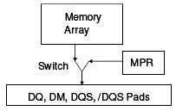
Multi Purpose Register(Cont.)

Slide 120
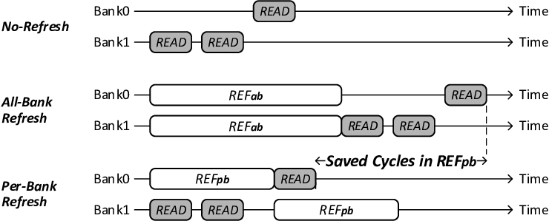
All Bank Refresh vs Per Bank Refresh

Slide 121
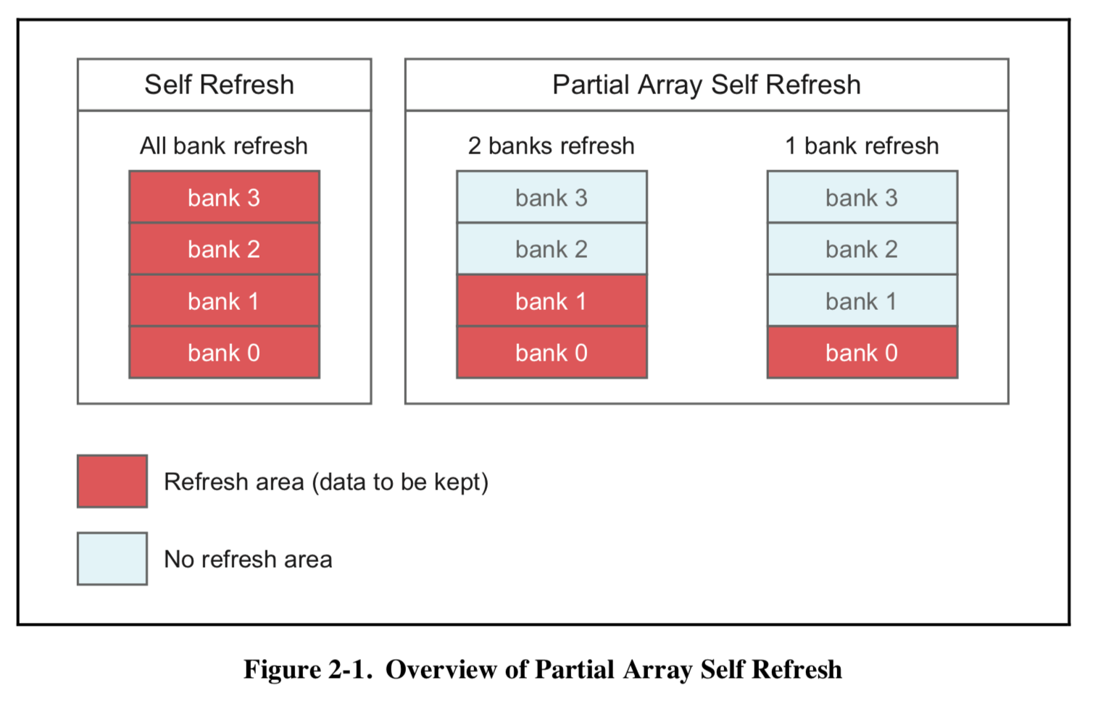
PASR
Partitial Array Self Refresh.
Only refresh the bank whch contains valid data.
Controller should know which bank should be refreshed, which bank don’t need to refresh.

Slide 122
ASR SRT
DDR3.
Auto Self Refresh & Self Refresh Temperature.
If the normal case temperature limit of 85°C is not exceeded, then neither SRT nor ASR is required, and both can be disabled throughout operation. However, if the extended temperature option of 95°C is needed, the user is required to provide a 2x refresh rate during (manual) refresh and to enable either the SRT or the ASR to ensure self refresh is performed at the 2x rate.
SRT forces the DRAM to switch the internal self refresh rate from 1x to 2x. Self refresh is performed at the 2x refresh rate regardless of the case temperature.
ASR automatically switches the DRAM’s internal self refresh rate from 1x to 2x. Howev- er, while in self refresh mode, ASR enables the refresh rate to automatically adjust be- tween 1x to 2x over the supported temperature range. One other disadvantage with ASR is the DRAM cannot always switch from a 1x to a 2x refresh rate at an exact case temper- ature of 85°C. Although the DRAM will support data integrity when it switches from a 1x to a 2x refresh rate, it may switch at a lower temperature than 85°C.
Since only one mode is necessary, SRT and ASR cannot be enabled at the same time.

Slide 123
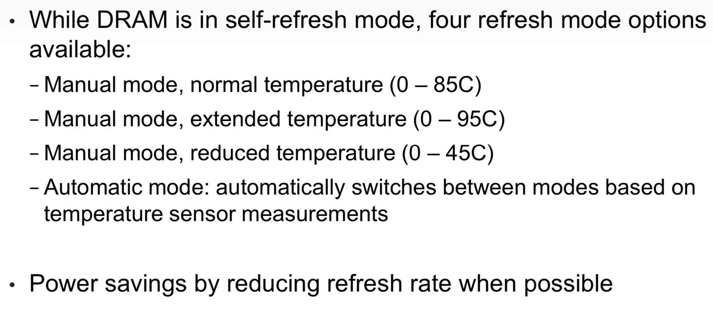
LPASR
PC4.
Low Power Auto Self Refresh.

Slide 124
TCSR
Temperature Compensated Self Refresh.
Mobile DDR SDRAM incorporates several low power functionalities
into DDR SDRAM to reduce the standby current.
To further reduce the self refresh current, it also lengthens the refresh period for lower temperature.
??

Slide 125
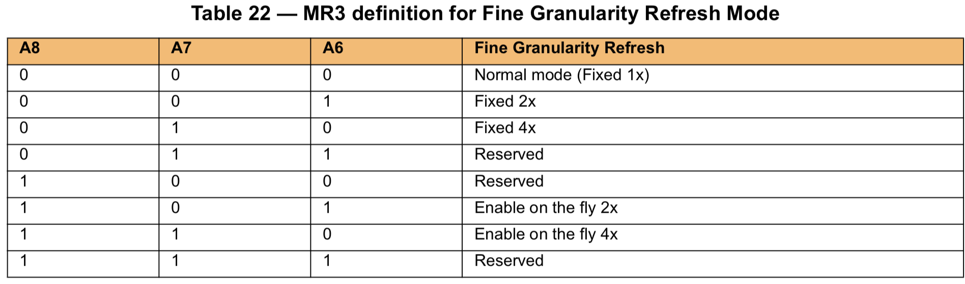
Fine Granularity Refresh
PC4.
Set the accurate refresh mode: 1x/2x/4x..

Slide 126
Self Refresh Abort
PC4/LP4.
Why self refresh abort?
During internal DRAM memory refreshes, the memory controller has no visibility to when this refresh is initiated. As a result, the controller is designed to wait for an entire refresh cycle (tRFC, plus a guard band, e.g., 10 ns) before issuing a command to the DRAM. The time period a memory controller must wait before issuing a valid command is herein referred to as tXS (i.e., tRFC+10 ns). tRFC for a 2 Gbit device is in the range of 160 ns. The tRFC approximately doubles as DRAM devices increase in density (e.g., tRFC for a 4 GBit device is in the range of 300 ns, tRFC for an 8 Gbit device is in the range of 550 ns), thus increasing tXS.
Therefore it is desirable to reduce the value of tXS for DRAM devices in order to reduce the time a memory controller must wait before issuing valid commands.

Slide 127
Power Down Mode
Power Down Mode - can modestly save system power at the expense of higher DRAM latency by putting DRAM into a quiescent state after a period of inactivity.
Power Down and Self Refresh are 2 low power states of DRAM devices. One of the primary differences between these states is that in the Self Refresh state, the DRAM executes internal refreshes which allows the memory controller and PHY to be disabled for a long time. In the power down state, the DRAM still requires refresh commands to be sent to maintain the memory contents.
LP4: Entering power-down deactivates the input and output buffers, excluding CKE and RESET.
Maximum power-down duration is governed by the refresh requirements of the device.

Slide 128
Maximum Power Saving Mode
PC4.
This mode provides lowest power consuming mode which could be similar to the Self-Refresh status with no internal refresh activity. When DDR4 SDRAM is in the maximum power saving mode, it does not need to guarantee data retention nor respond to any external command (except maximum power saving mode exit and asserting RESET_n signal LOW) to minimize the power consumption.

Slide 129
DPD(Deep Power Down)
LP3
The JEDEC standard specifies a Deep Power-Down (DPD) mode, in which the entire memory array shuts down. All internal voltage generators inside the device stop and all data is lost, as is all the information in the Mode Register Set (MRS) and the EMRS.

Slide 130
Loopback Mode
DDR5.
Enables testing of the DQ and DQS signaling between the controller and the DRAM, isolating the actual memory array since read/write accesses are not needed.

Slide 131
Target Row Refresh
Row Hammer.
When a target row of a dynamic random access memory (DRAM) is activated too many times within a time period, the data stored at adjacent rows, which are physically adjacent to the target row, may be disturbed or lost. In particular, due to increasing density of DRAM design, the data stored at an adjacent row may be corrupted due to noise generated from the frequent activation of the target row.
Testing for TRR support: It should be possible to test whether a memory controller supports Target Row Refresh (TRR) and has it enabled. If TRR is enabled, then if we repeatedly activate two different rows, we should see a delay when the memory controller refreshes their four neighbouring rows.
LP4: MR24.

Slide 132


WCK
LP5.
LPDDR5 introduces WCK clock, similar to GDDR5.
LPDDR5 operates at two differential clocks CK_t and CK_c, while data interface uses two differential forward clocks WCK_t and WCK_c. WCK_t and WCK_c can operate at two times or four times the frequency of command/address (operation) clock (CK_t/CK_c).

Slide 133

Write X
LP5.
In order to reduce power consumption during read and write operations, a couple of optional functions which copy internal data are included in an LPDDR5 specification. Among them, the write-X function that is implemented in this chip writes all zeros data to DRAM cells without DQ and WCK operation.

Slide 134

DVFS
LP5.
“DVFS (Dynamic Voltage Frequency Scaling)” is a technology that optimizes power consumption by controlling the power supply voltage according to the level of the operating frequency. In a speech, Samsung pointed out that mobile DRAM does not often require the highest data transfer rate in actual usage. For example, LPDDR4 SDRAM has a maximum data transfer rate of 3.2Gbps / pin, but in practice, it was often used in the range of 800Mbps / pin to 1.6Gbps / pin.
Specifically, the power supply voltage (VDD2H) of the data path is normally 1.05V, but is lowered to 0.9V (VDD2L) when the transfer speed is 1.6 Gbps or less. The power supply voltage (VDDQ) of the input / output driver is normally 0.5V, but is lowered to 0.3V when the transfer speed is 3.2Gbps or less.

Slide 135
Deep Sleep Mode
LP5.
DSM ((Deep Sleep Mode) is an improved version of the standby power consumption mode “SR-PD (Self Refresh Power-Down)” that was installed in LPDDR4X SDRAM. In SR-PD mode, the self-refresh interval is constant. However, in DSM, the refresh interval is shortened and the burst is continuously executed, while the refresh is not executed for a long period, and the leak current is suppressed by stopping the internal voltage generation circuit. As a result of devising, it is said that DSM was able to reduce standby power consumption by 25% compared to SRDDR mode of LPDDR4X.

Slide 136

IDD
What’s IDD?
The current draw from the VDD terminal of the device (the IDD).
Demo of DDR3L vs DDR4 IDD:

Slide 137
Illegal operation or timing
LP3:
Operation or timing that is not specified is illegal, and after such an event, in order to guarantee proper operation, the LPDDR3 device must be powered down and then restarted through the specified initialization sequence before normal operation can continue.

Slide 138
Bit Flip will cause crash?
Maybe, maybe not.
Consider that many data file, eg: audio, movie, text file, if one bit flip occurs, the instructions are normal, so the system may be work normally!

Slide 139
Reference
Google Search.
Wiki.

